Slide 1
Lesson 1:
LO: To understand what it means to be grateful and generous
Listen to the words of this song.
What are you grateful for in God’s creation?

Slide 3
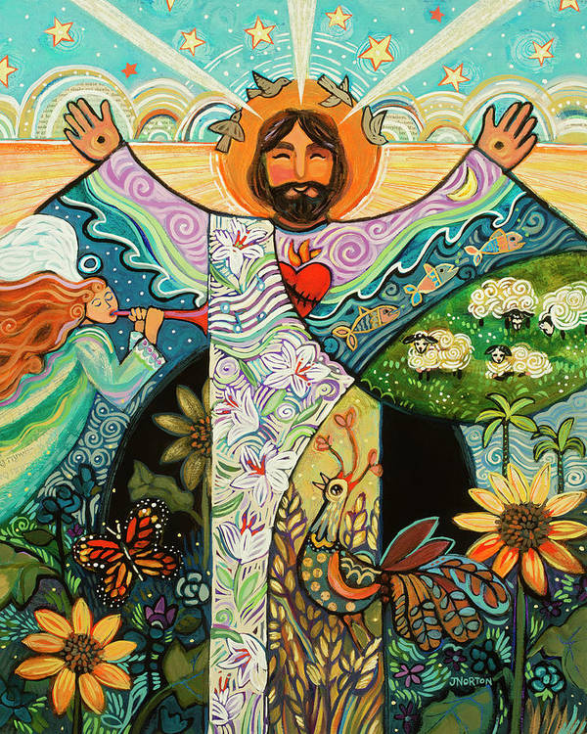
Share the story of creation together.
What images of God’s creation can you see in this picture?
What is your favourite part of the creation story?

Slide 4
Task: Create a mind map to show all of the things in God’s creation that you are grateful for.
I am grateful for the sun that shines brightly over me.
I am grateful for the gifts and talents that God has given to me.
Extension: Why is it important to be grateful and generous?

Slide 5
I am grateful for _______
____________________
____________________
I am grateful for _______
____________________
____________________
I am grateful for _______
____________________
____________________
I am grateful for _______
____________________
____________________
I am grateful for _______
____________________
____________________

Slide 7
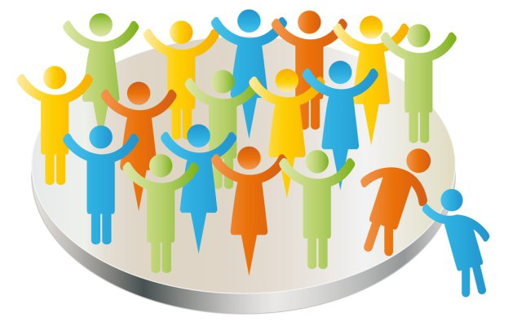
Belong
Lesson 1:
Unit A
LO: To understand what it means to be part of a group
What does it mean?
Can you think of any other words?
Dictionary definition:
To be a part of something.

Slide 8
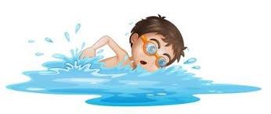
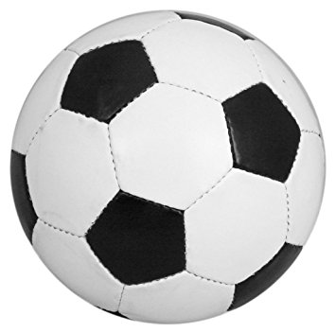
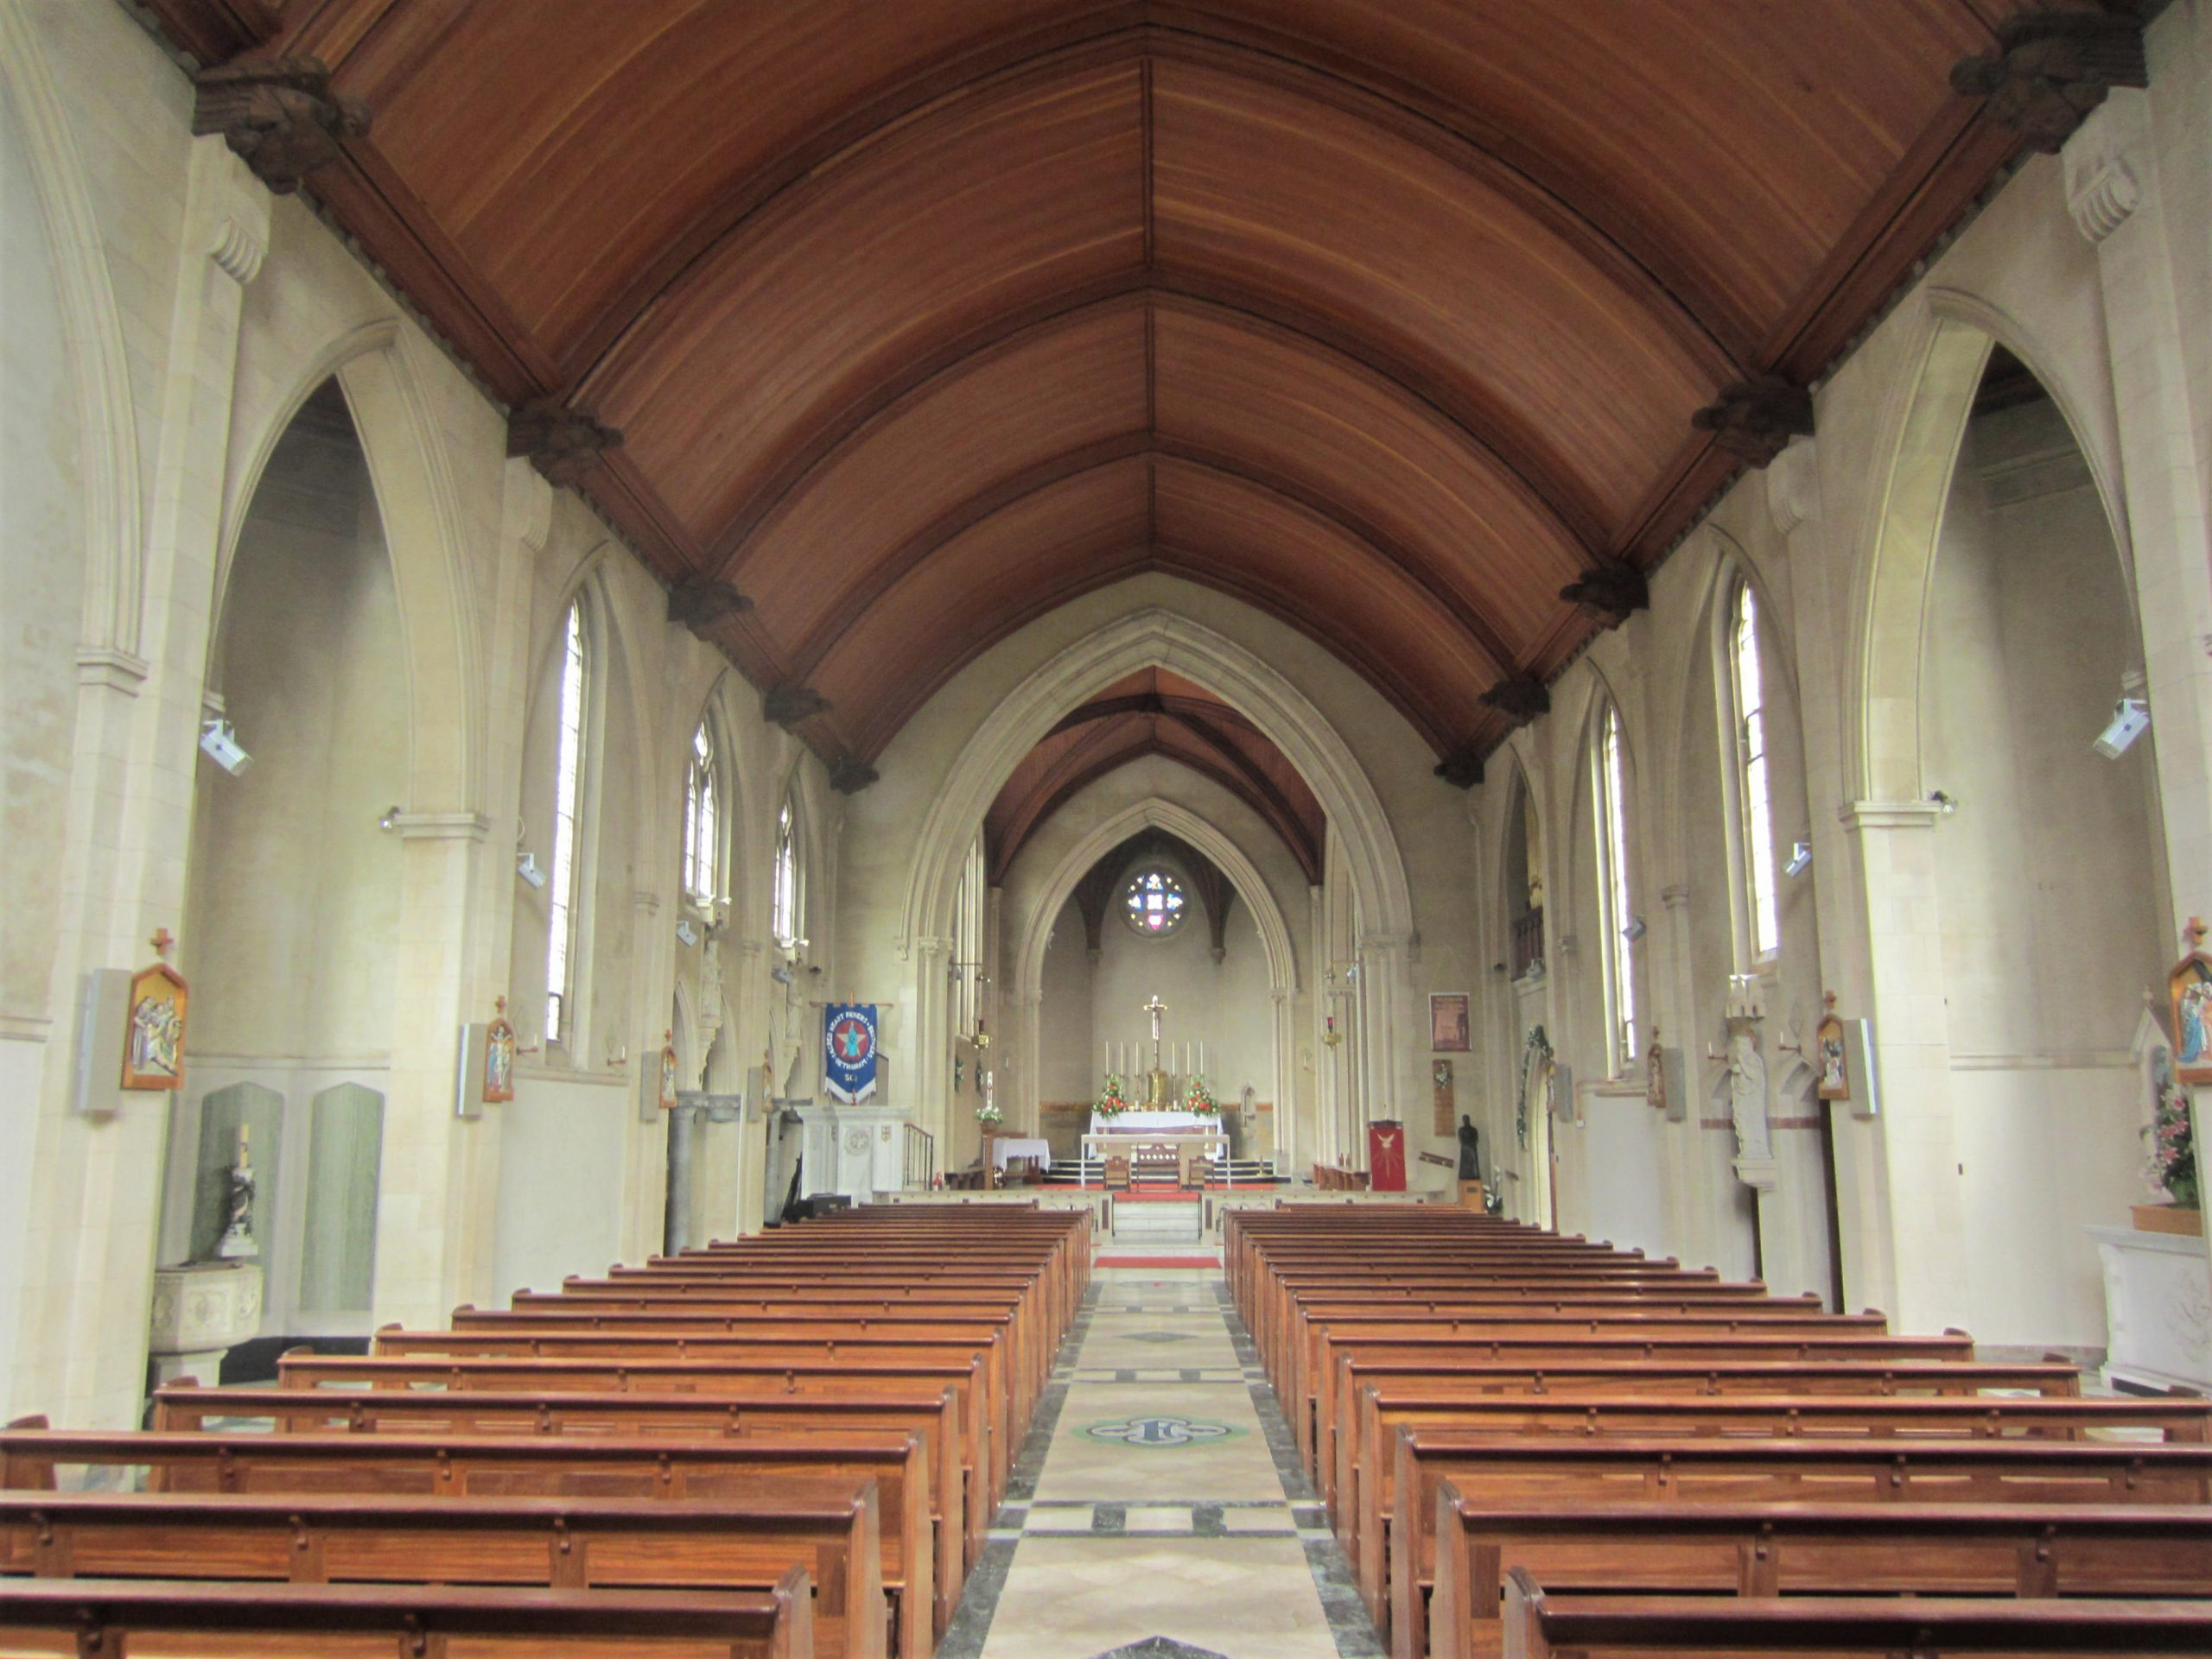
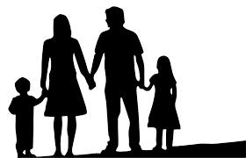
Where groups do you belong to?
Notes:
Children to think and talk about the different groups they belong to. (e.g. family, school, class, church, cubs and brownies etc.)
What do they like about belonging to these different groups?

Slide 9
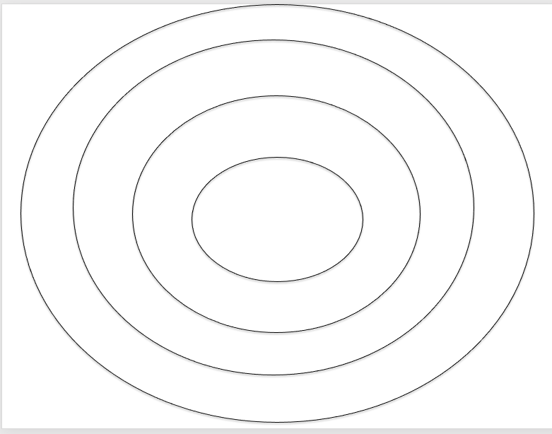
Task 1:
Write the names of the groups you belong to on a separate post it note.
Rank the groups that you belong to in order of importance.
If a group is really important, put it closer to the middle.
Karate
Extension:
Why have you ordered the groups this way?
Football
My family
Notes:
Paired task. Children to rank the groups they belong to in order of importance. Why have they ordered them in this way?
Take pictures to go into RE books.

Slide 11
Think about the groups that you belong to:
- Have you got any special roles or responsibilities?
- Are there any signs or symbols of your group?
Group: | Role or responsibility: | Signs or symbols:
Our Lady of Compassion school | My role is to listen and learn lots of new things.
Notes:
Discuss these questions together. Go through what a role or responsibility is.
Share and model example with the class.
Model another example with the class.

Slide 12
Task 2: Create a table to show the different groups that you belong to
Group: | Role or responsibility: | Signs or symbols:
Our Lady of Compassion school | My role is to listen and learn lots of new things.
Challenge: What is the most important group that you belong to?
Notes:
Children to complete the task on the table provided.
See differentiated sheet and word bank for LA pupils.

Slide 13
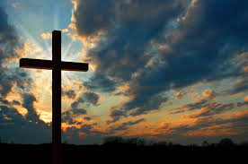
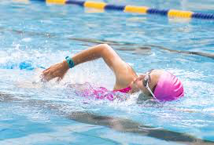

Slide 14
Lesson 2:
Unit A
LO: To know the story of Jesus calling the disciples

Slide 15
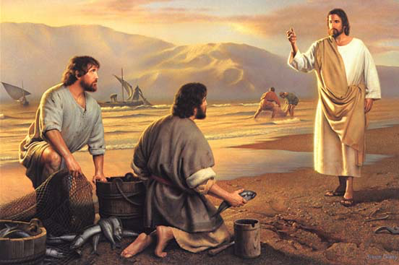
How does this picture link to belonging?
Notes:
Gradually reveal picture of Jesus with some of his disciples.
Emphasise that it was important for Jesus to share his life with other people and welcome them into friendship with him. The disciples became a special group that belonged to Jesus.

Slide 16
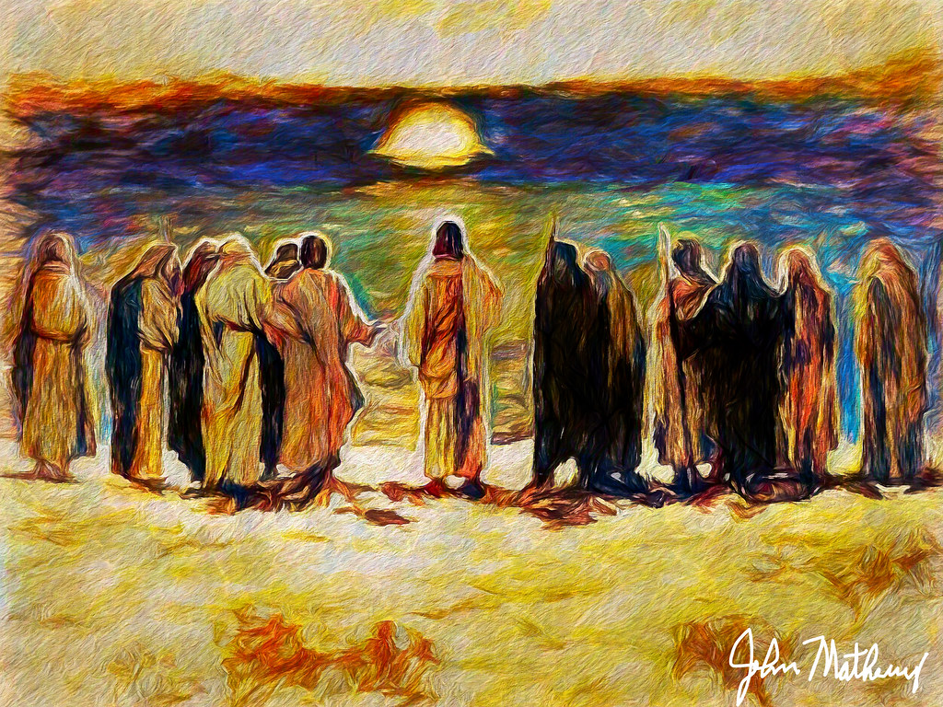
What can you remember about Jesus’ disciples?
What were their names? What jobs did they do?
Notes:
Ask children to recall what they can remember about the disciples.

Slide 17
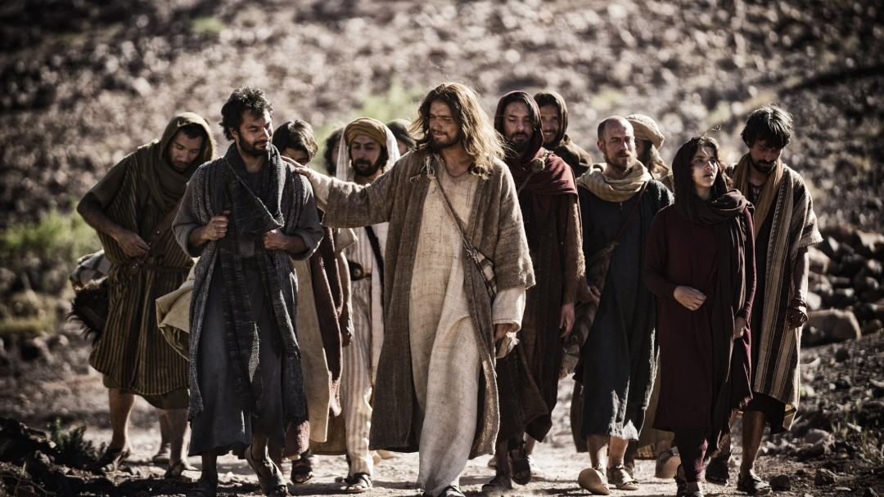
Read the story of Jesus calling the disciples by name - Mark 3 13-19
Notes:
Emphasise that the disciples were called by name to follow Jesus. They were specially chosen by Jesus.

Slide 18
Imagine this scene as if you had been one of the twelve.
How would you have felt?
How would you have reacted if you had been chosen?
Why do you think Jesus wanted to share his life with these people? Can you recall any other stories of Jesus and the disciples together?
Notes:
Discuss these questions together.
Emphasise that this was a special choice that Jesus made

Slide 19
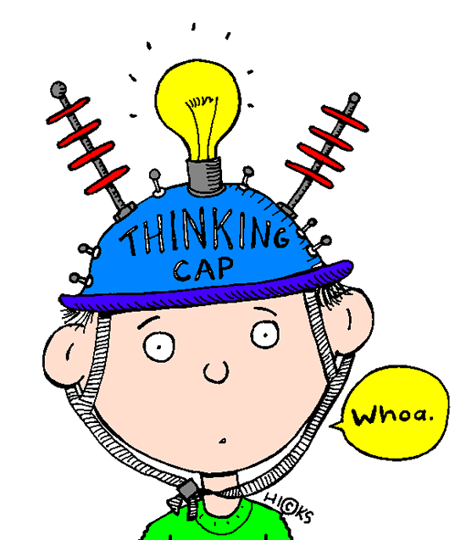
Imagine you were called to be a disciple. What questions might your family ask?
Notes:
Ideas:
What happened?
How did you feel?
Were you tempted to say no?
Are you excited?
Is there anything you’re worried about?
Why do you think you were chosen?

Slide 20
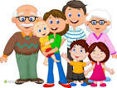
Role play: Imagine you have been chosen as a disciple. Act out the conversation you would have with your family/ friends
You will not believe what happened to me today!
Where have you been son? What has happened?
Notes:
Children to work in pairs to complete role play task. 1 person to be a chosen disciple, the other person to be a family member.
Children could also swap roles if they wanted to.
Before they start discuss key questions that family might ask.
Take photos to go into RE book.

Slide 21
Could the disciples have said no?
Notes:
Discuss end question together. What would have happened if they did say no?

