Slide 1
Comparing countries of the uk

Slide 2
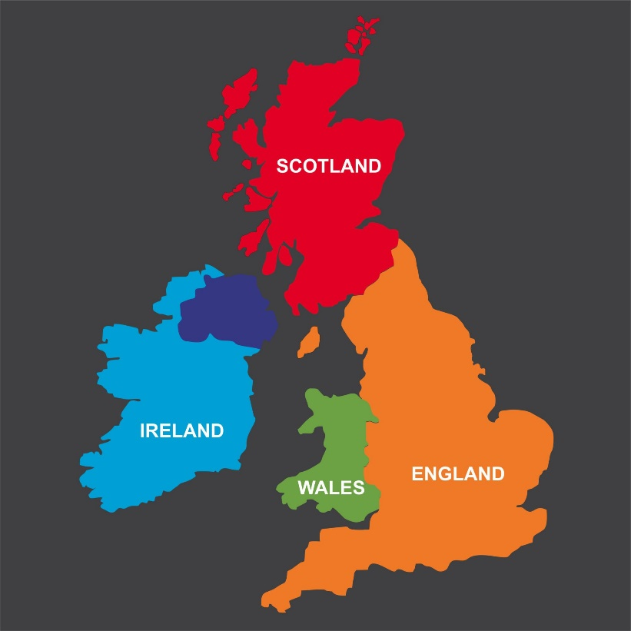
Lesson 1
L.O: What is the UK?

Slide 3
Do you think these pictures are in the Uk? Which country do the belong to?

Slide 12
Lesson 2
L.O: What is the UK?

Slide 13
Recap
Can you name thecountries of the UK?

Slide 14
Quiz
Can you name the flags?

Slide 20
Which country is which?

Slide 24
Label the different countries

