Slide 2
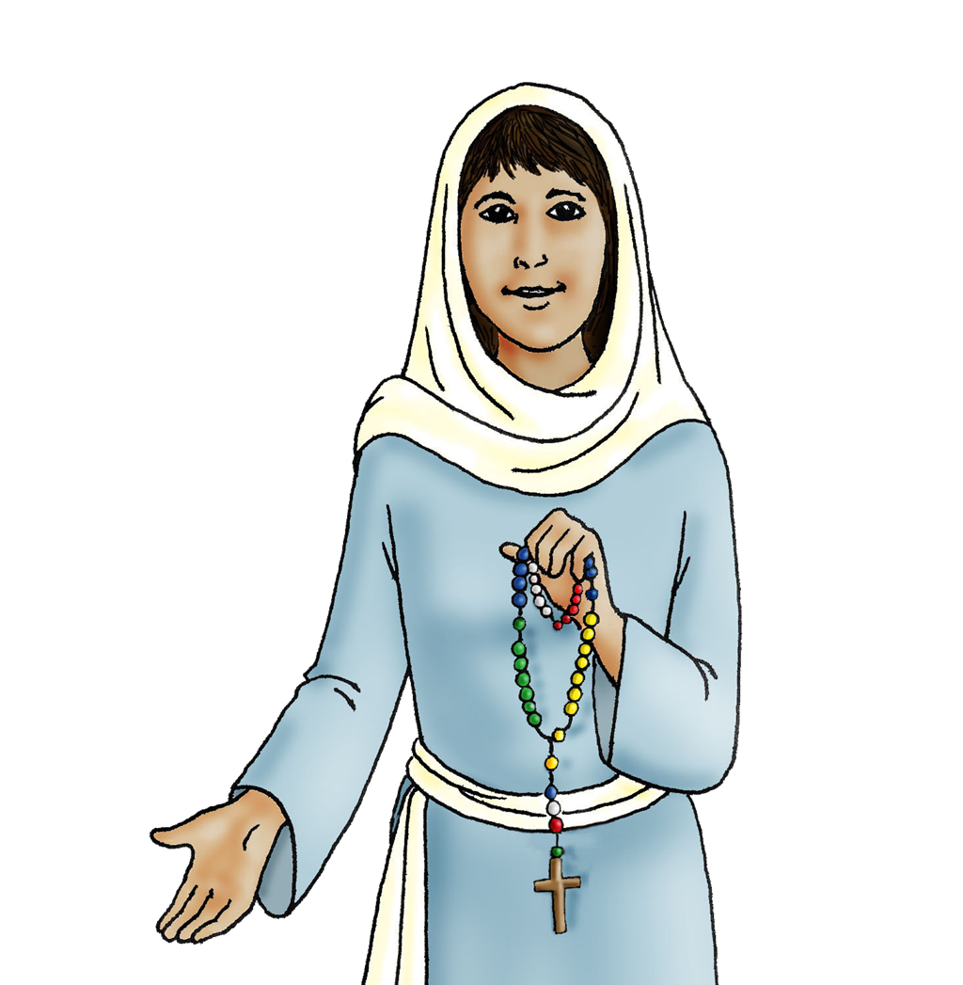
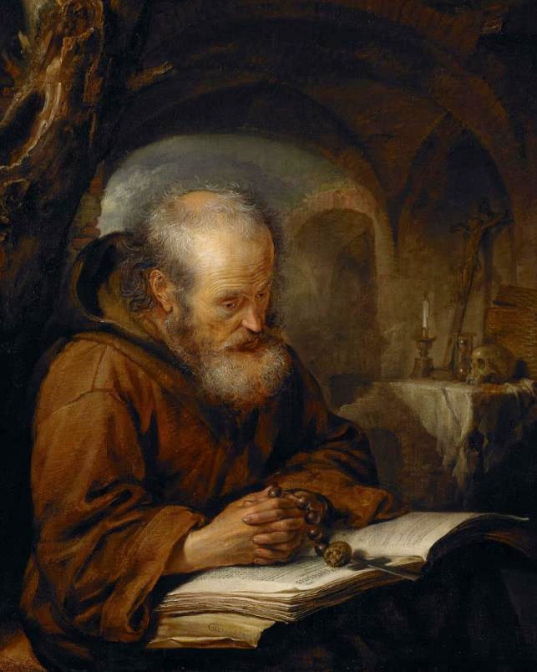
Our Lady
of the
Rosary

Slide 3
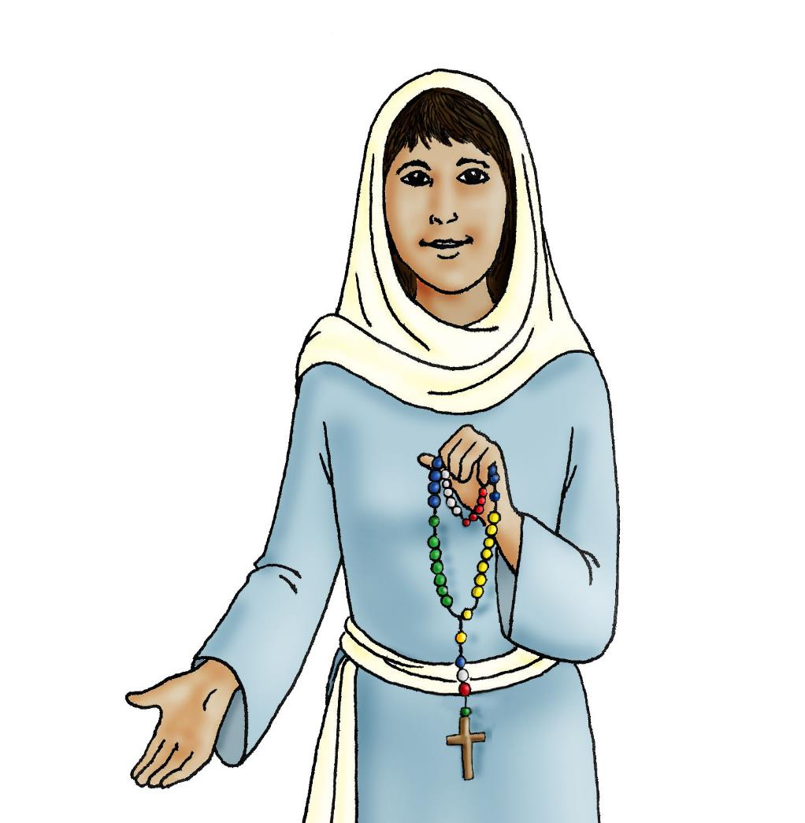
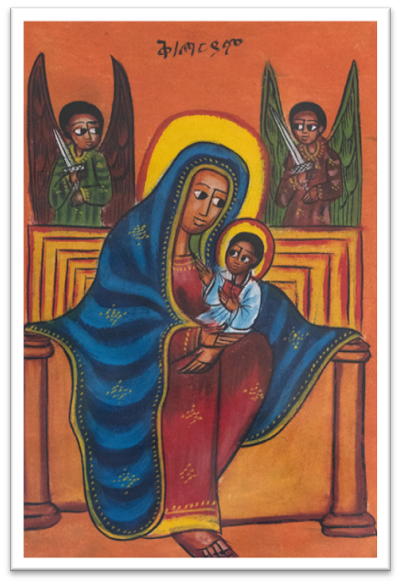
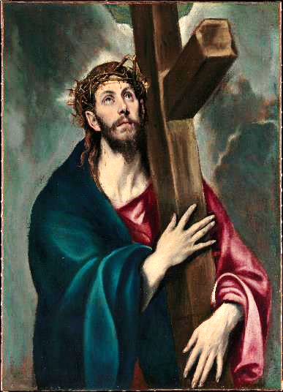
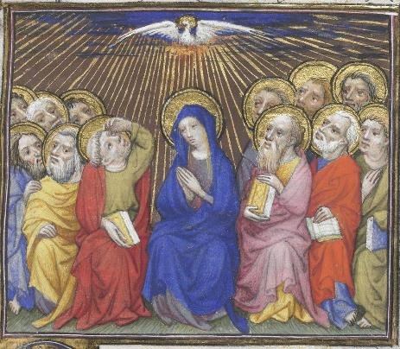

Slide 4
The Joyful Mysteries
The Annunciation
Mary learns that God has chosen her to be the mother
of Jesus.
The Visitation
Mary visits her cousin Elizabeth, who is also pregnant. Elizabeth will be the mother of John the Baptist.
The Nativity
Jesus is born in a stable in Bethlehem.
The Presentation
Mary and Joseph take the infant Jesus to the Temple to present him to God.
The finding of Jesus in the Temple
Jesus is found in the Temple discussing his faith with elders and teachers of the Jewish law.
The Glorious Mysteries
The Resurrection
God the Father raises Jesus from the dead.
The Ascension
Jesus returns to his Father in heaven.
The Coming of the Holy Spirit
The Holy Spirit comes down at Pentecost.
The Assumption of Mary
At the end of her life on earth, Mary is taken into heaven.
The Coronation of Mary
Mary is crowned as Queen of Heaven and Earth.
The Sorrowful Mysteries
The Agony in the garden
Jesus prays in the Garden of Gethsemane on the night before he dies.
The Scourging at the pillar
Jesus is beaten and whipped.
The Crowning with thorns
Jesus is mocked and crowned with thorns.
The Carrying of the cross
Jesus carries his cross to Golgotha.
The Crucifixion
Jesus is nailed to the cross and dies.

Slide 5
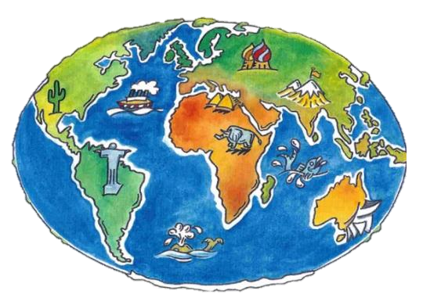
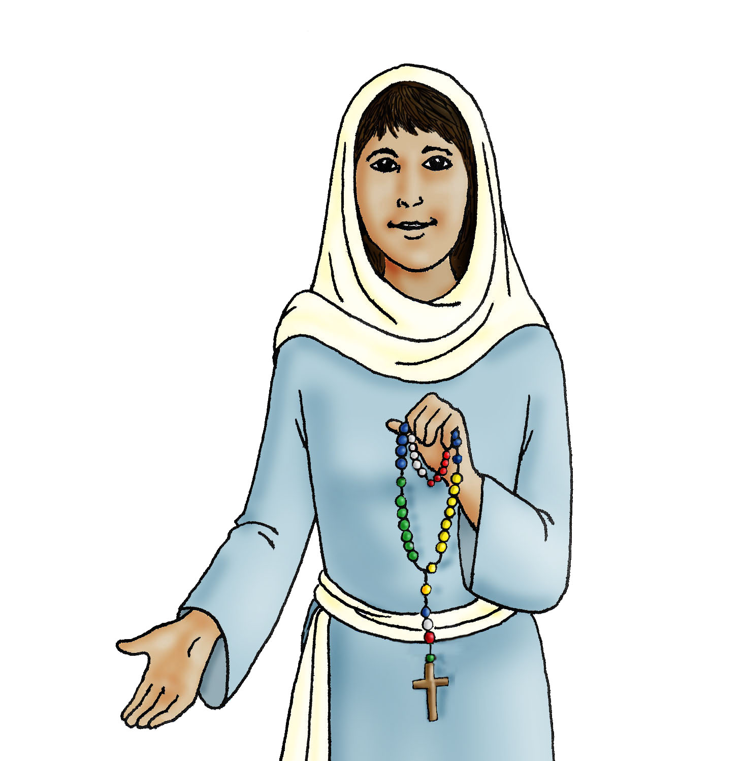
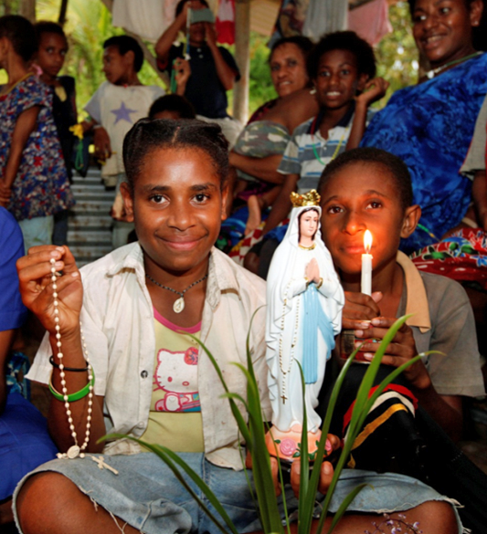
Papua New Guinea

Slide 6
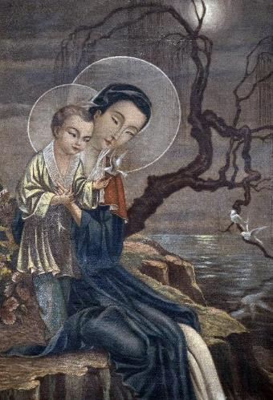
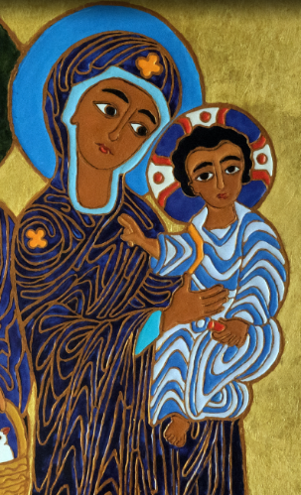
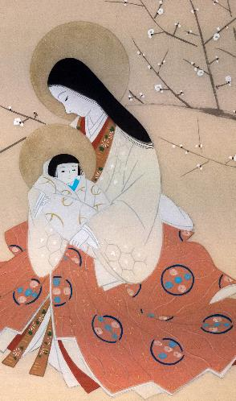
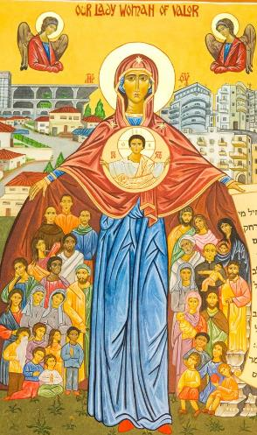
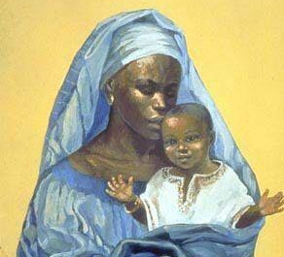
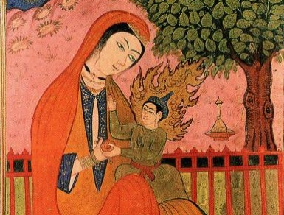
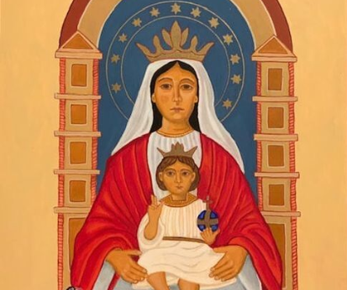

Slide 7
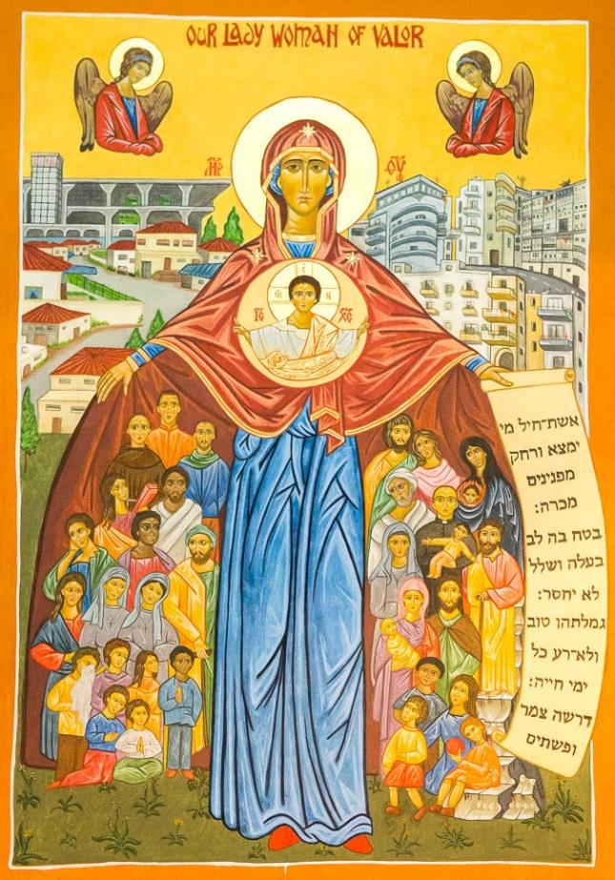
A reading from the Acts of the Apostles
After Jesus ascended to heaven, the apostles went back to Jerusalem from the Mount of Olives.
When they entered the city, the apostles went to the upstairs room where they were staying. They all continued praying together, along with Mary the mother of Jesus.
The Word of the Lord
R/ Thanks be to God

Slide 8
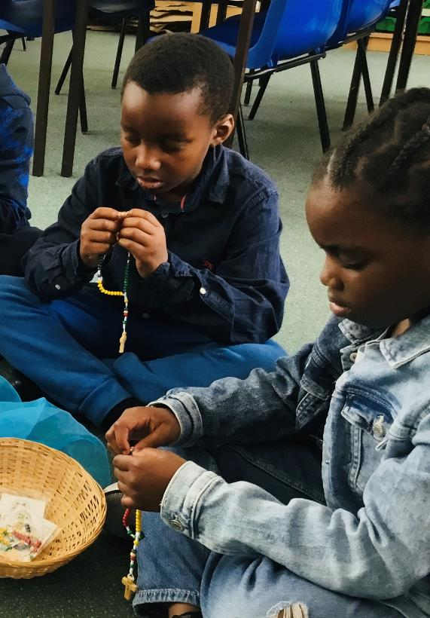

Slide 9
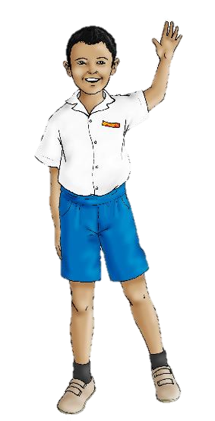
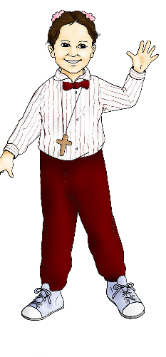
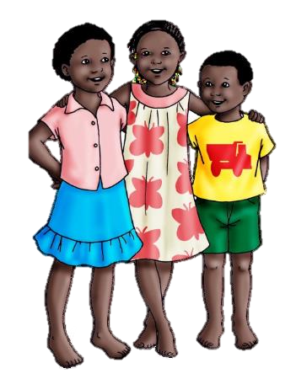
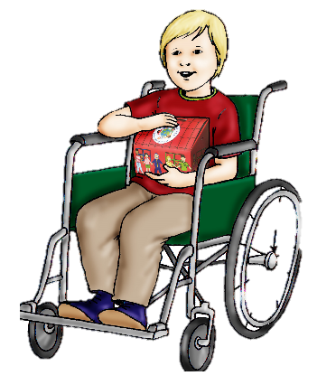
Hail Mary, full of grace,
The Lord is with thee.
Blessed art thou among women,
And blessed is the fruit of thy womb, Jesus.
Holy Mary Mother of God,
pray for us sinners,
now and at the hour
of our death.
Amen

