Slide 1
Session 5: Testing the game
To test and improve the game

Slide 2
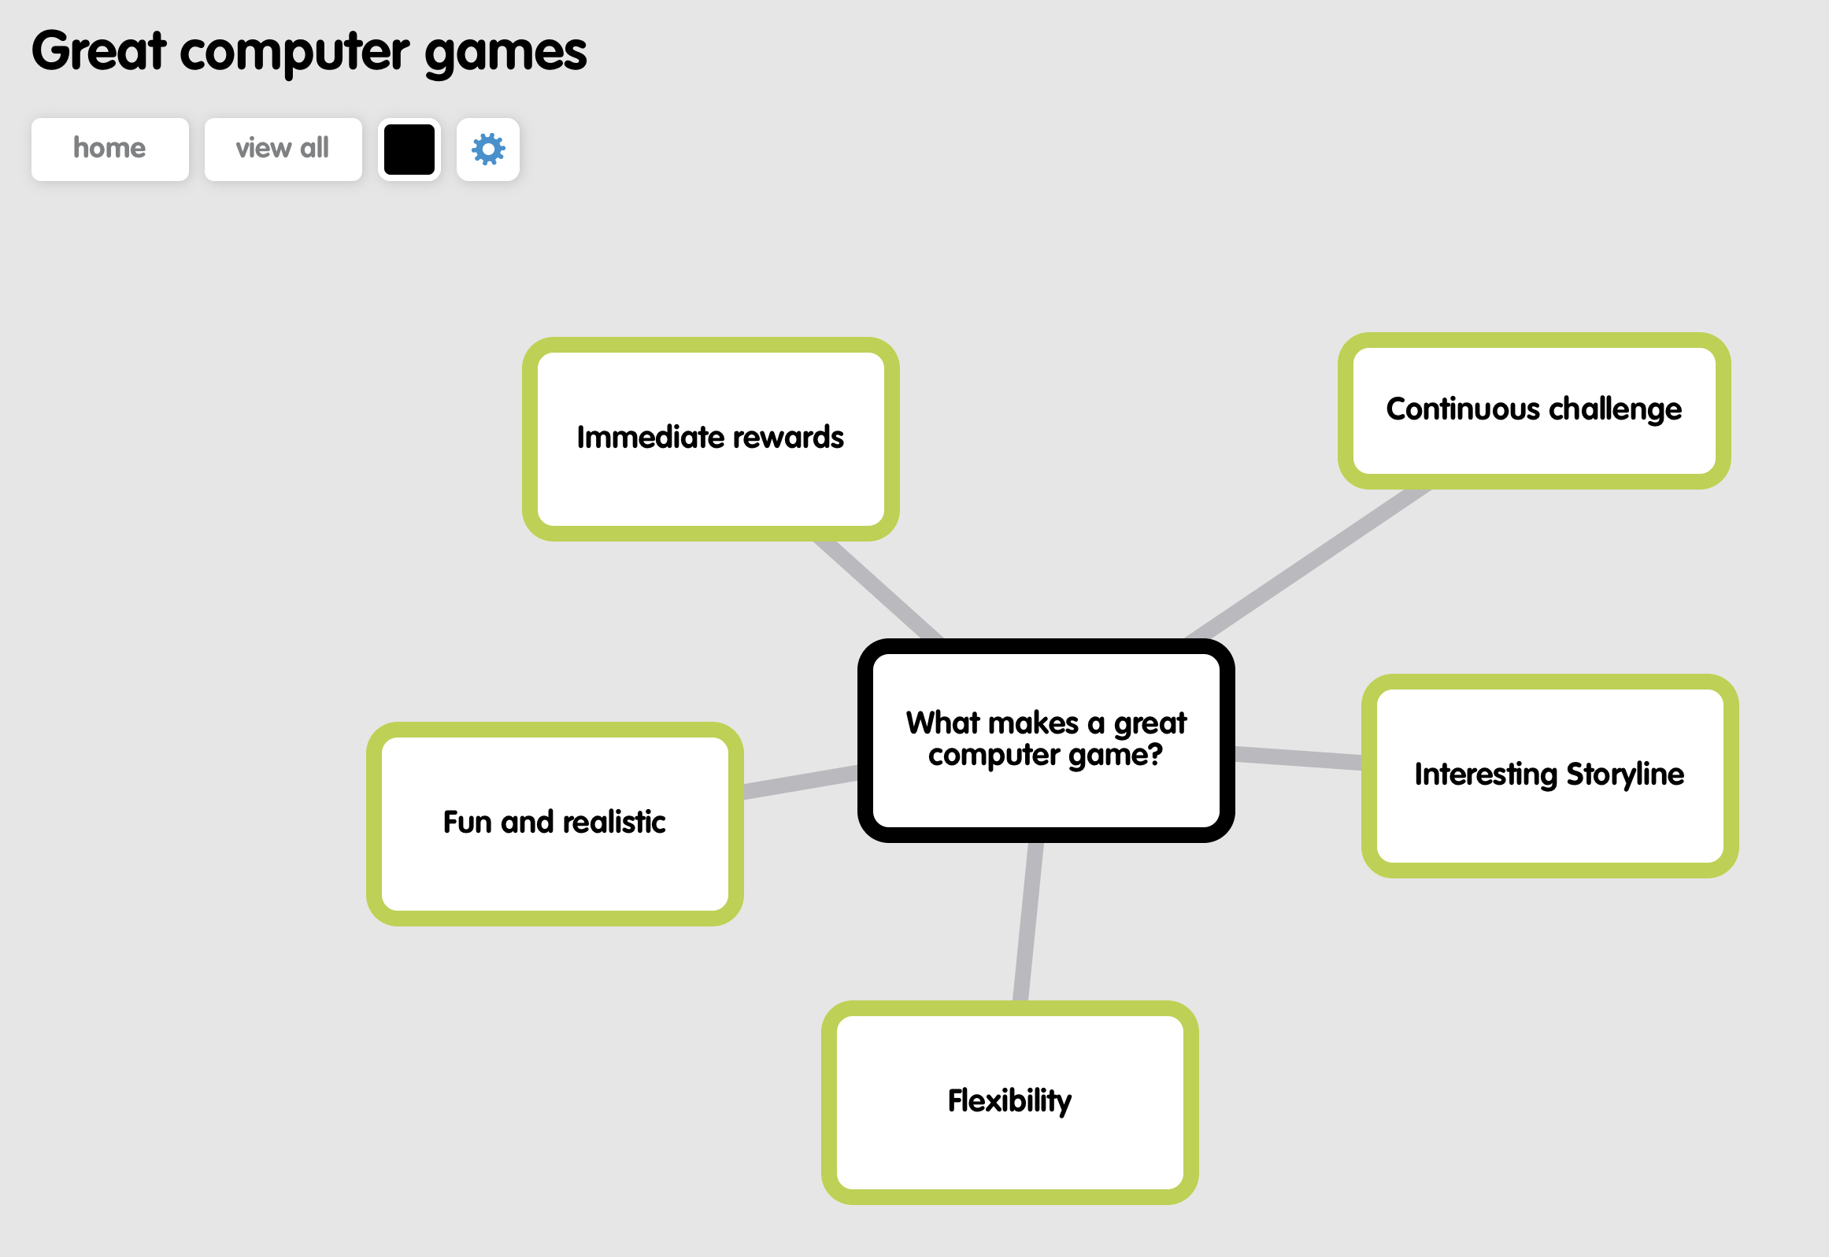
Let’s review
Do you remember the criteria for what makes a good computer game from Session 1?
Use these criteria to assess your game.
You might ask the following questions:
How easy is the game for a beginner to play?
Does the game offer sufficient challenge to make someone want to play it more?
Are the graphics and sound as effective as they could be?

Slide 3
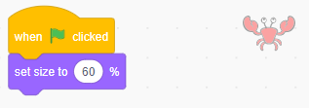
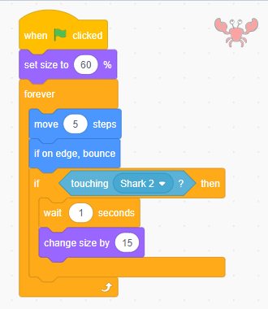
Let’s learn
Work to improve your game based on your assessment. For example, one way we are going to make our game more challenging and interesting is by making the crab grow when the shark hits it – making an obstacle for the shark.
Let’s do
Start the crab program with a when green flag clicked block. Connect the set size to block and reduce its size to 60%.
Add a forever block loop and insert:
Motion blocks for the crab – move 5 steps and if on edge, bounce.
an if/then block, holding a touching Shark 2? block.
a wait 1 seconds block. Connect a change size by block to this and set a number to increase the size by a certain percentage, such as 15.
1
2
a
a
b
b
c

Slide 4
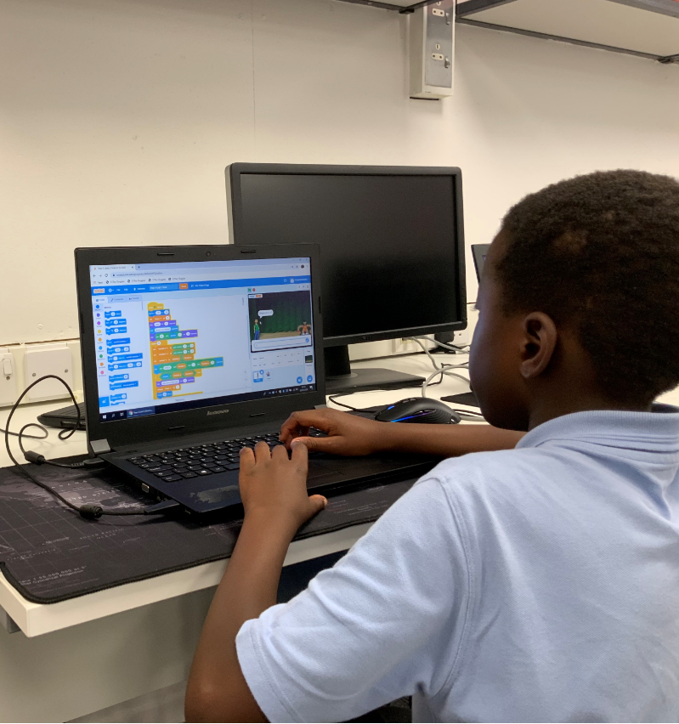
Let’s learn
The key to creating a good computer game is testing it on users and developing it further based on their feedback.
Let’s do
You will be assigned another pupil (or pair) to test your game and provide feedback on it.
Remember to give specific suggestions for how the game might be improved.
Write your suggestions down so that the programmers can work through the list.

Slide 5
Let’s do
Take time to make the changes suggested by the testers, working through their list.
Remember to test after each of the changes has been made to ensure that there are no bugs in the edited programs and that new features work properly.

