Slide 1
After the Storm
How much can you remember?

Slide 2
As Percy lay in bed, he could hear a storm outside.
True
False

Slide 3
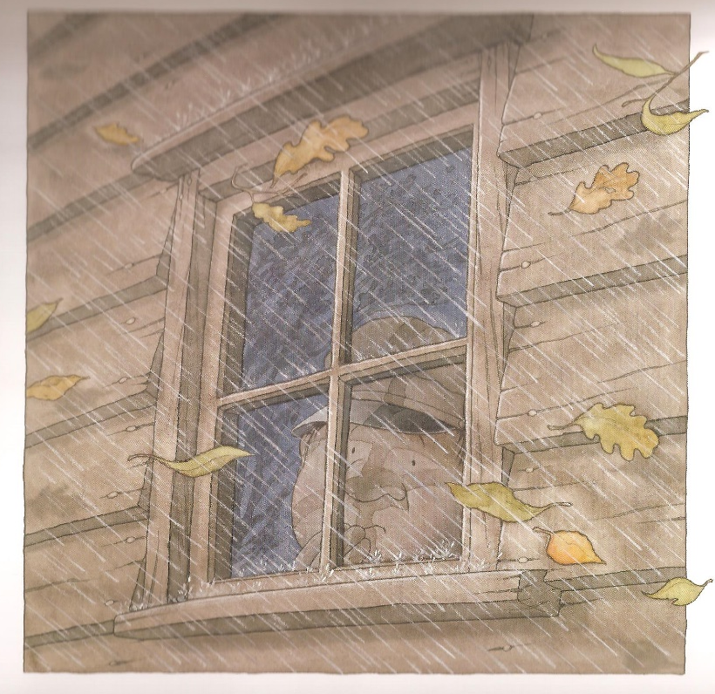
Percy didn’t like the thunder and lightning.
True
False

Slide 4
The next day the weather was nice and the storm had caused no damage.
True
False

Slide 5
The storm had destroyed a tree which lots of the animals lived in.
True
False

Slide 6
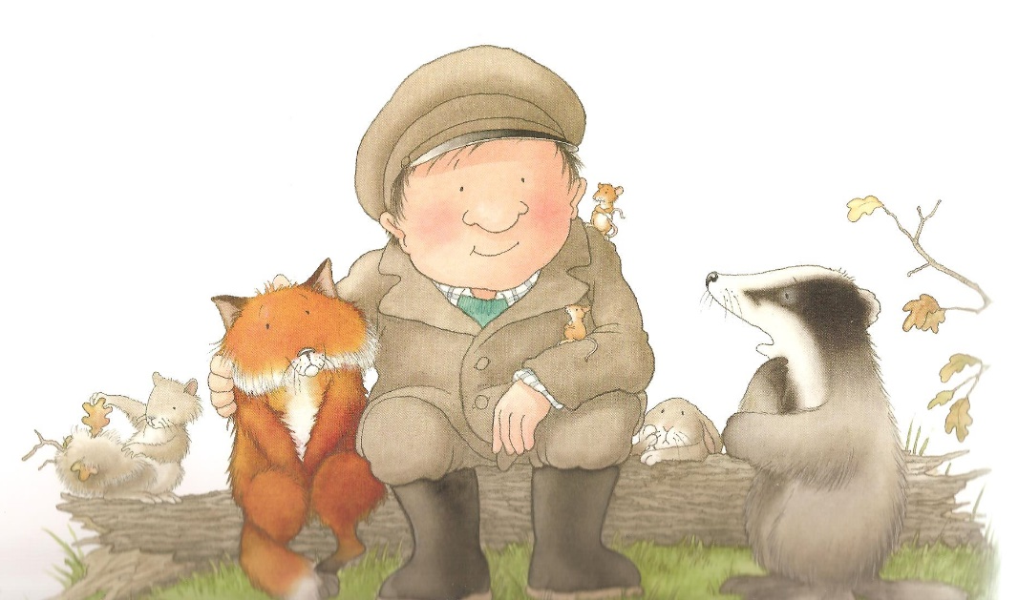
Even though their home had been destroyed, the animals were happy.
True
False

Slide 7
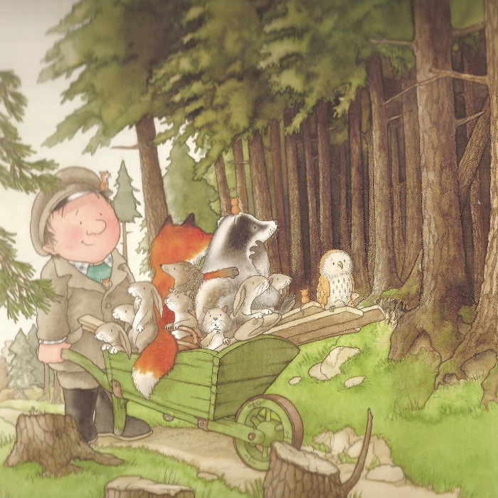
Percy tried to find the animals new homes, but none of them were suitable.
True
False

Slide 8
Percy and the animals crossed the bridge safely.
True
False

Slide 9
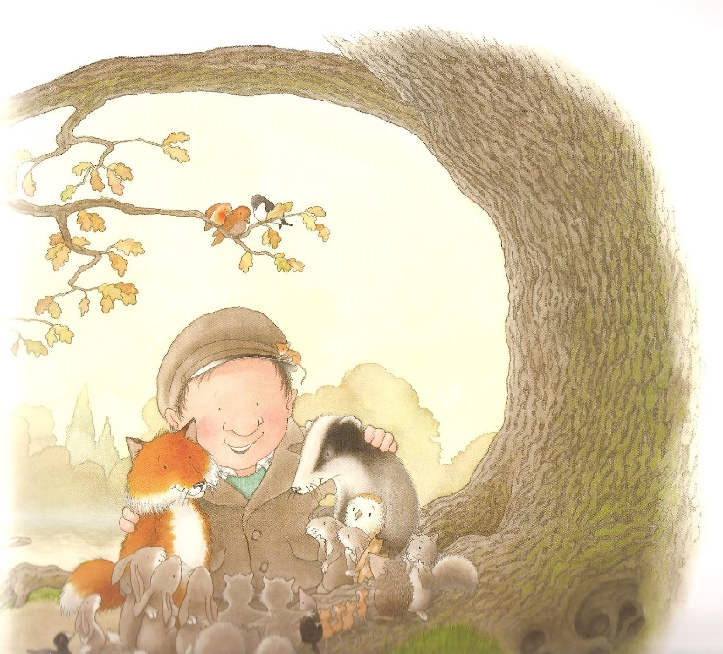
On the other side of the lake, Percy spotted the perfect place for the animals’ new home.
True
False

Slide 10
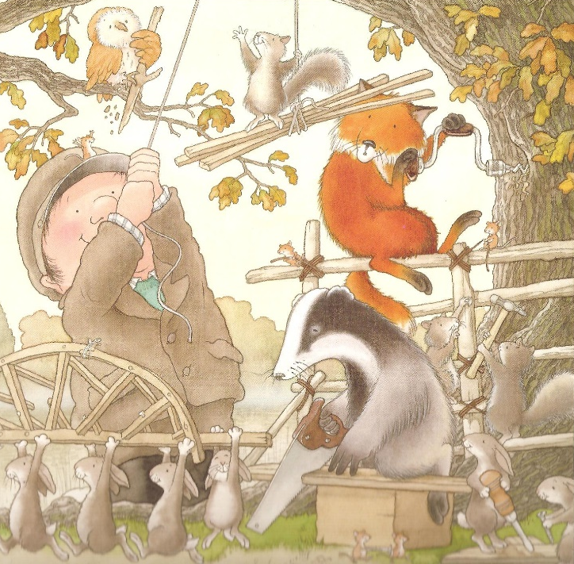
The animals watched whilst Percy built them a treehouse.
True
False

Slide 11
When the treehouse was built, Percy wanted to go straight back to his hut.
True
False

Slide 12
Well done!

