Slide 1
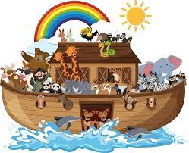
Monday 16th September 2024
LO: Express how Noah was feeling when he made a promise to God.
SC: Find Noah’s Ark in the Bible.
Retell the story of Noah.
Consider how Noah felt during this time.

Slide 2
The Big Question
Imagine you are Noah,
What would you have said to God when he asked for your help?
Key words:
Noah
Ark
God
Promise

Slide 3
Recall
Let’s refresh our minds by singing ‘Arky Arky’
https://www.youtube.com/watch?v=iYpftlQO5HQ

Slide 4
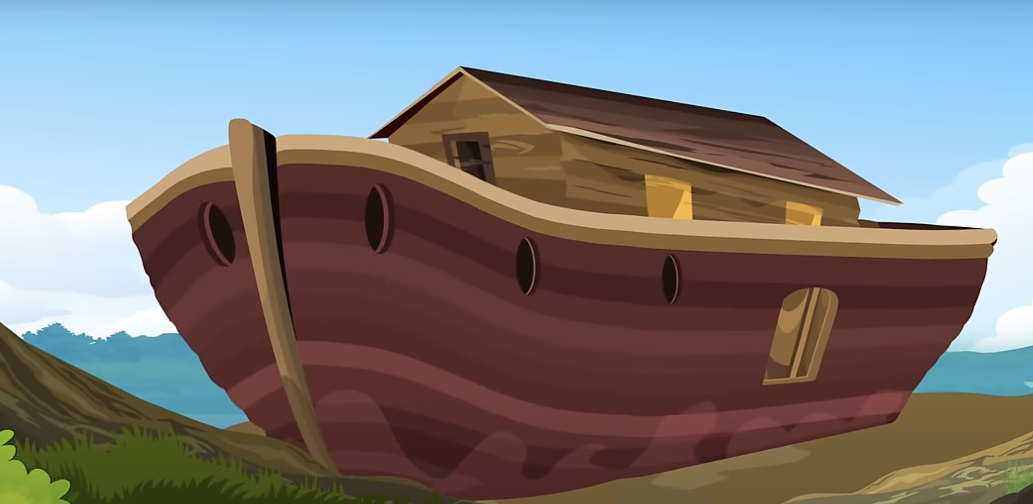
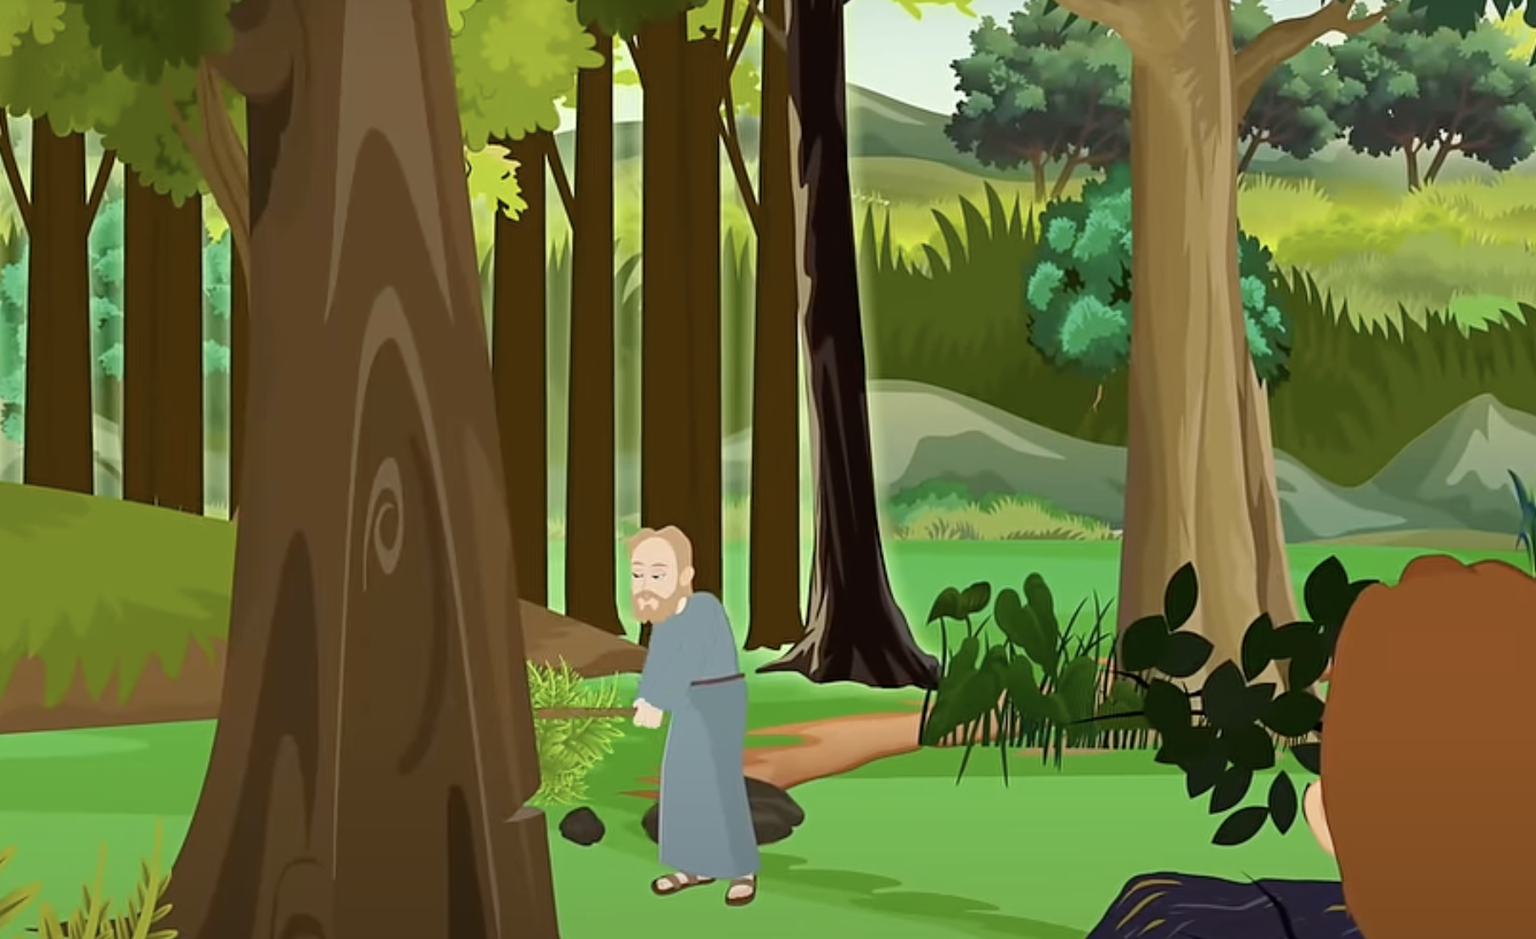
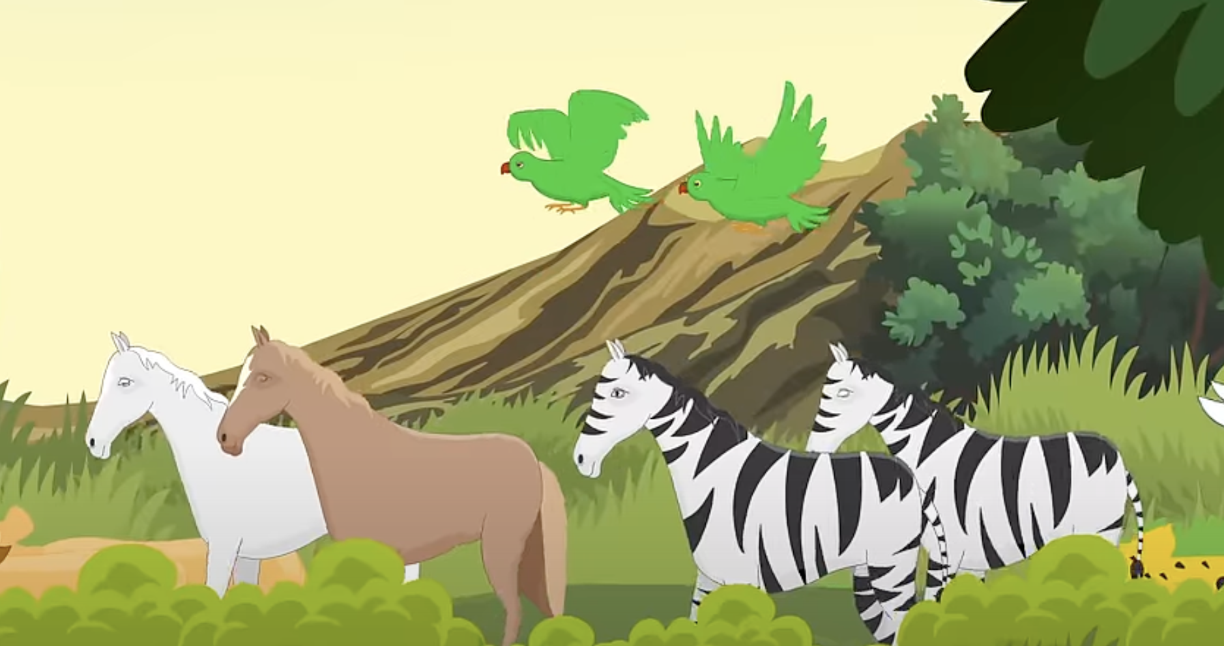
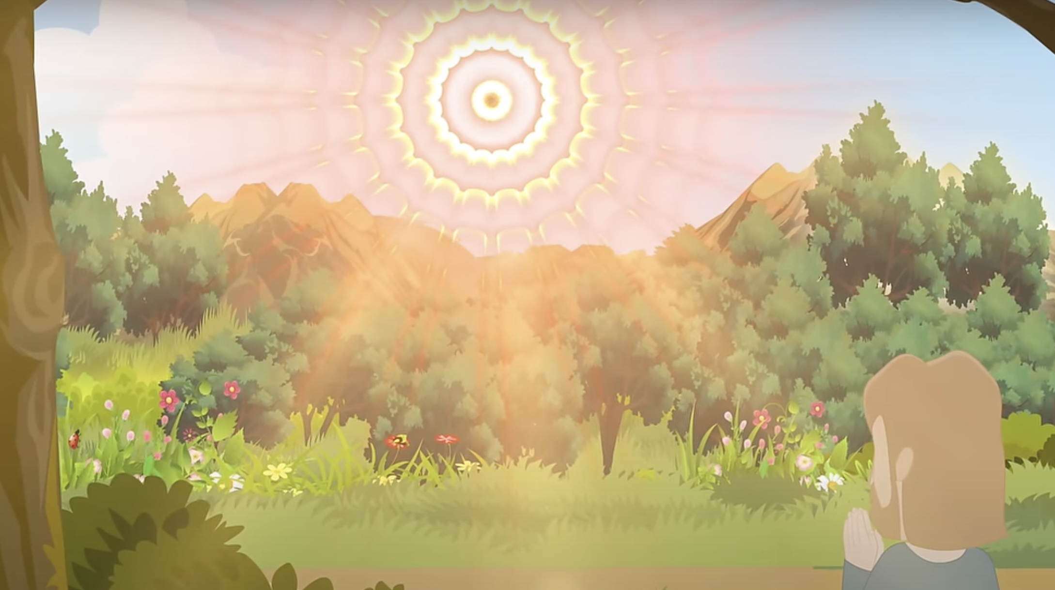
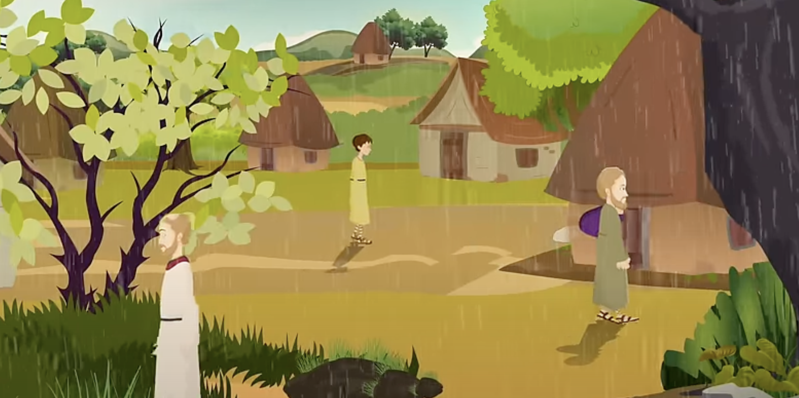
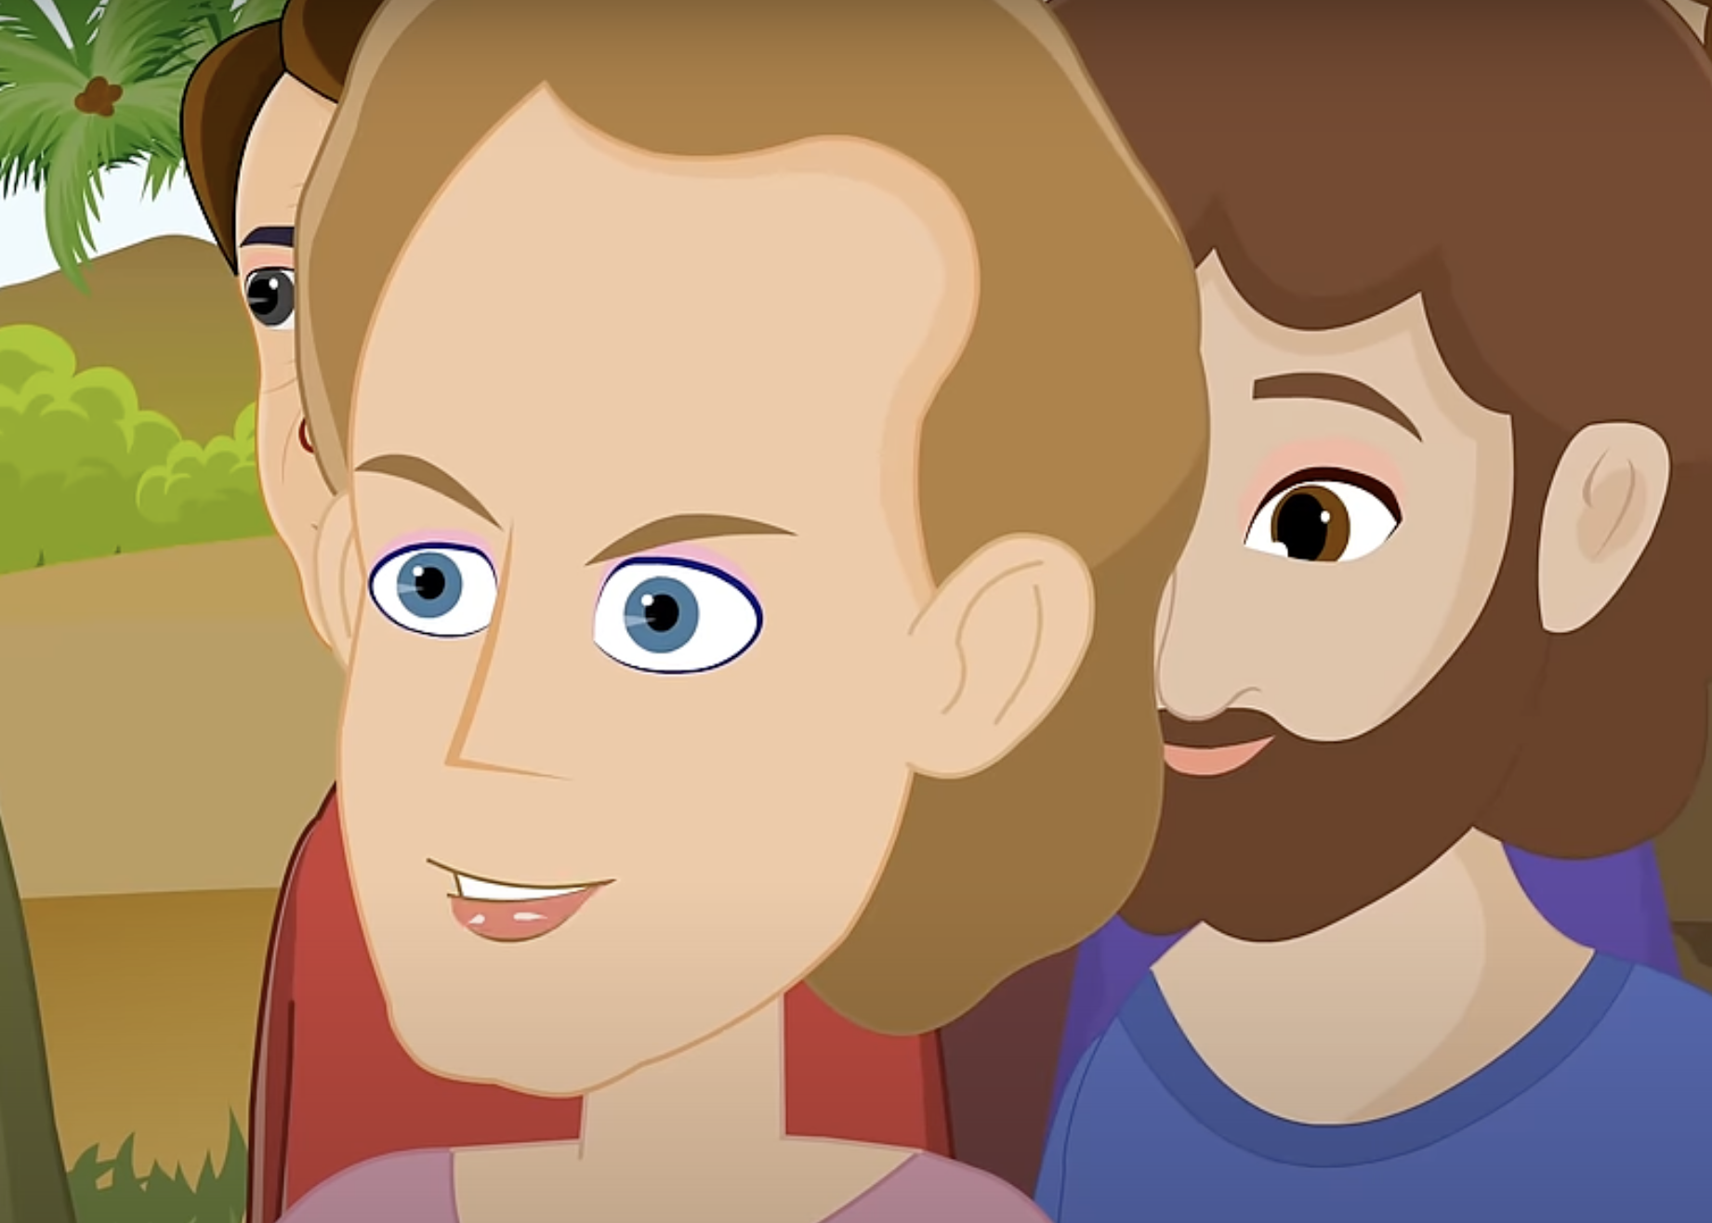
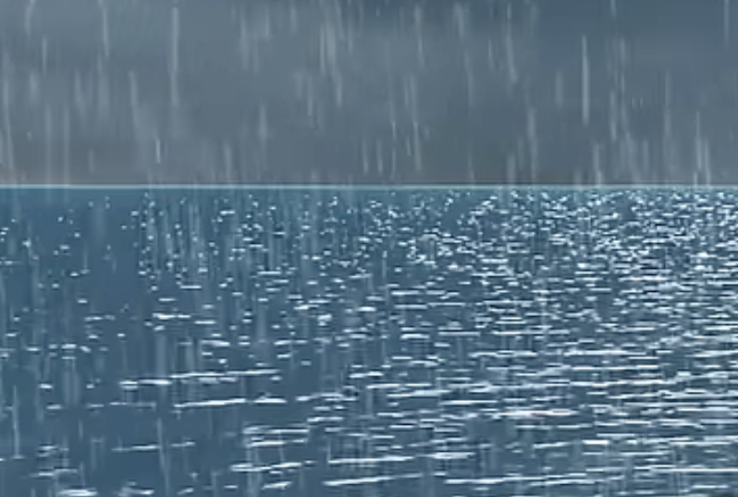
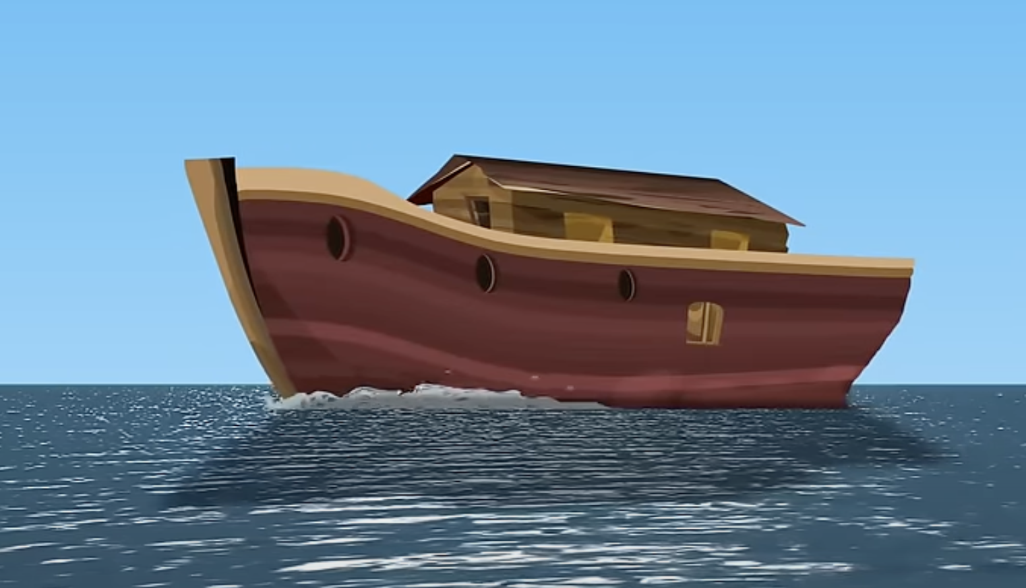
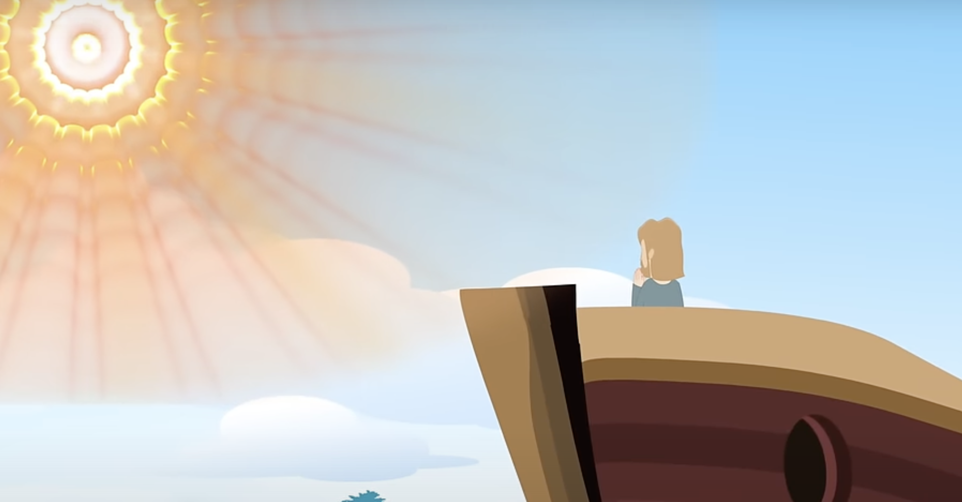
Recall
Thinking back to last lesson, can we put these images in the correct order?

Slide 5
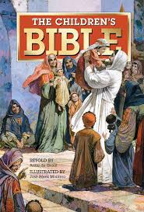
Noah’s Ark
It is time to be Bible detectives!
In pairs, we will have a go at finding Noah’s Ark in the Bible.
Let’s read it as a class.

Slide 6
Noah’s Ark
Why do you think Noah was chosen by God?
Why did no one believe Noah when he spread the word of God?
How do you think Noah was feeling when he was chosen by God?
What is a promise?

Slide 7
Main Activity
Identify the words in the text which speak about the promise.
Express how Noah was feeling when he made a promise to God.
What promise will you make to God?

Slide 8
The Big Question
Imagine you are Noah,
What would you have said to God when he asked for your help?

