Slide 1
Disclaimer/s
We hope you find the information on our website and resources useful.
Animations
This resource has been designed with animations to make it as fun and engaging as possible. To view the content in the correct formatting, please view the PowerPoint in ‘slide show mode’. This takes you from desktop to presentation mode. If you view the slides out of ‘slide show mode’, you may find that some of the text and images overlap each other and/or are difficult to read.
To enter slide show mode, go to the slide show menu tab and select either from beginning or from current slide.
You may wish to delete this slide before beginning the presentation.

Slide 3
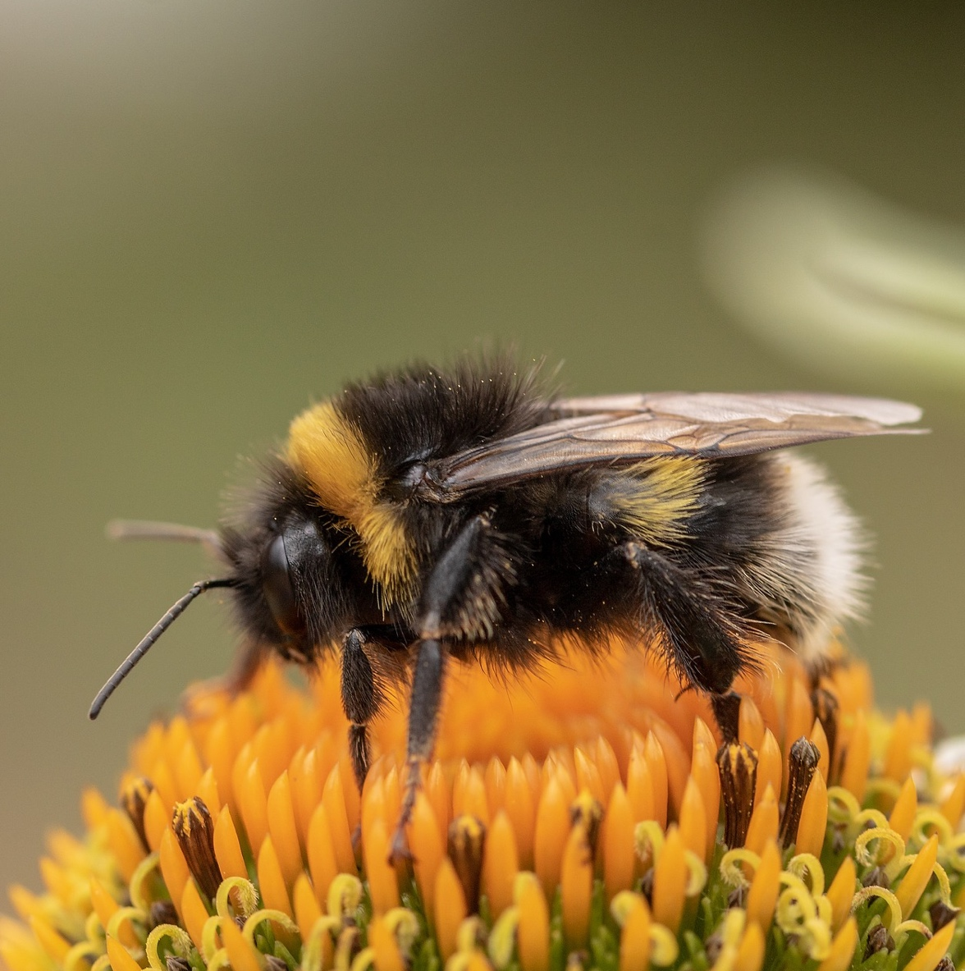
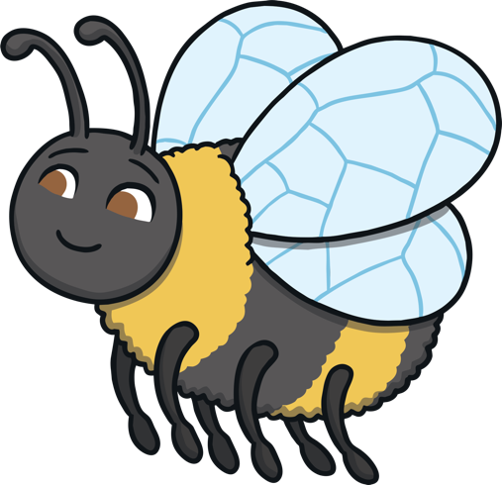
What Do We Know About Bees?
Have you ever seen a bee?
What do bees look like?
What noise does a bee make?
Do you know any facts about bees?

Slide 4
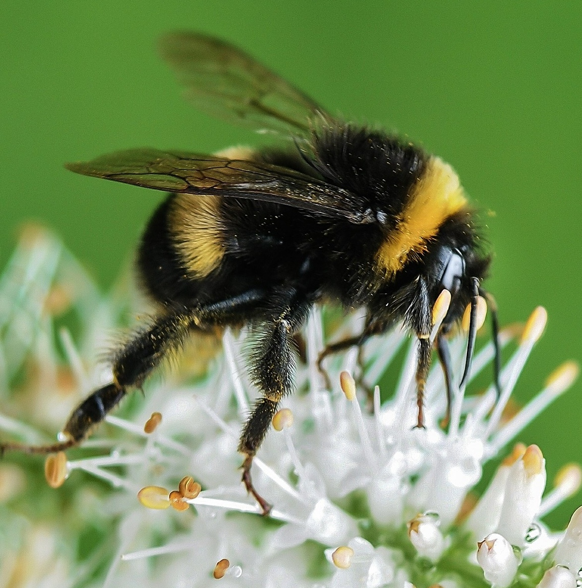
What Is a Bee?
Bees have 6 legs.
Bees have wings.
Bees are a type of flying insect.
Bees are very important as they
help to pollinate plants. This helps
plants to grow and produce food.
Can you name any other parts of my body?

Slide 5
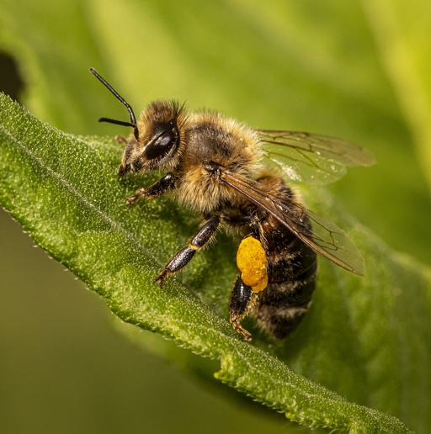
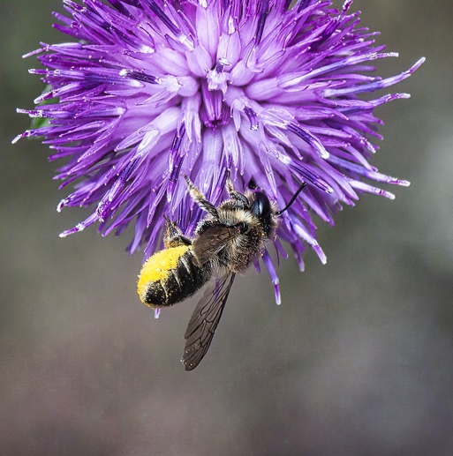
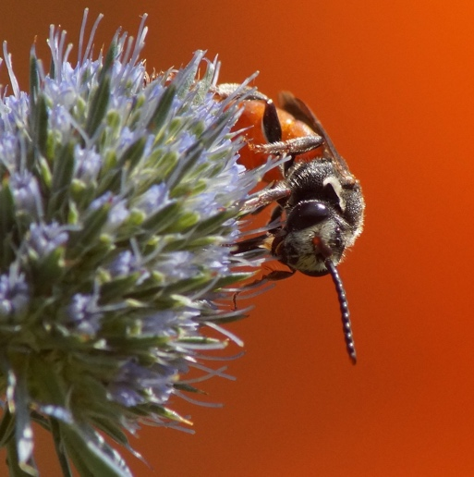
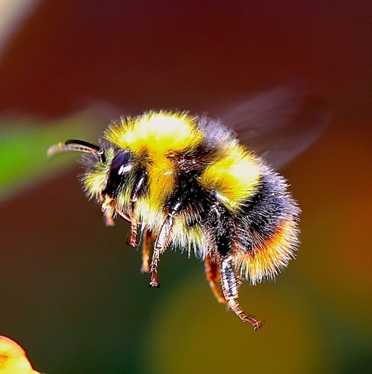
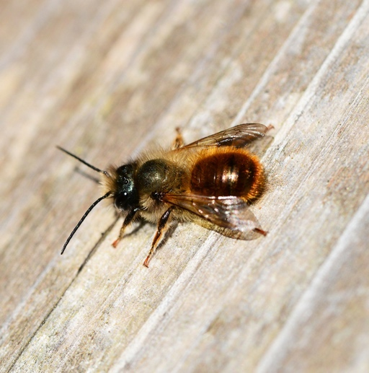
Different Types
of Bee
Did you know that there are over 25,000 different species of bees? Here are just a few of them.
Honey Bee
Leafcutter Bee
Furrow Bee
Bumblebee
Mason Bee

Slide 6
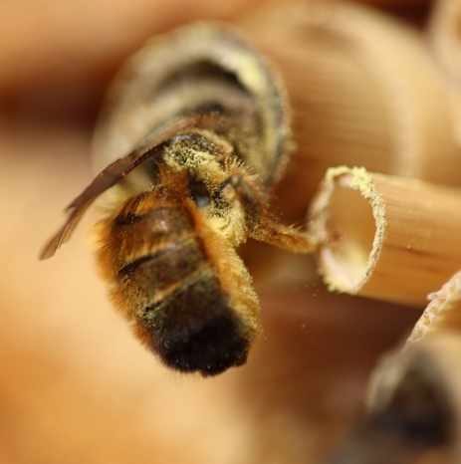
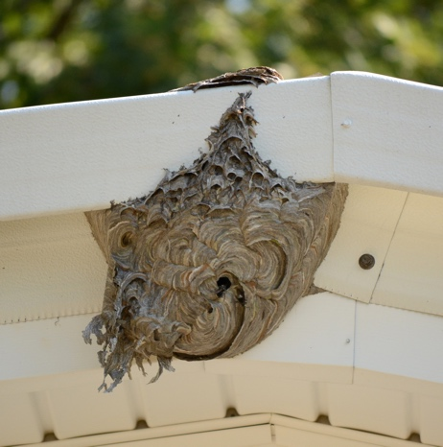
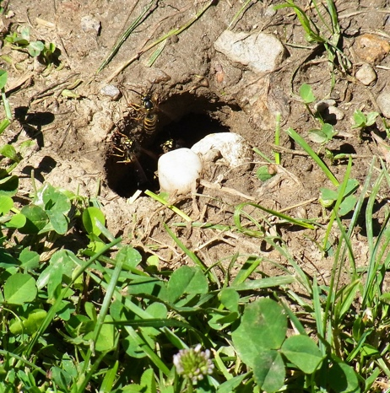
Where Do
Bees Live?
Some bees like to live inside plant stems or small holes.
Different types of bees like to live in different places. You might find bees living in hollow trees, underground or even in sand dunes.
Some bees like to make
their own nest. They might make a nest in
a tree, in a garden or under a roof.
Our nests help us to
protect our eggs, larva
and pupa. These
will develop
into bees.
Some bees like to build their nests in holes or empty tunnels underground.

Slide 7
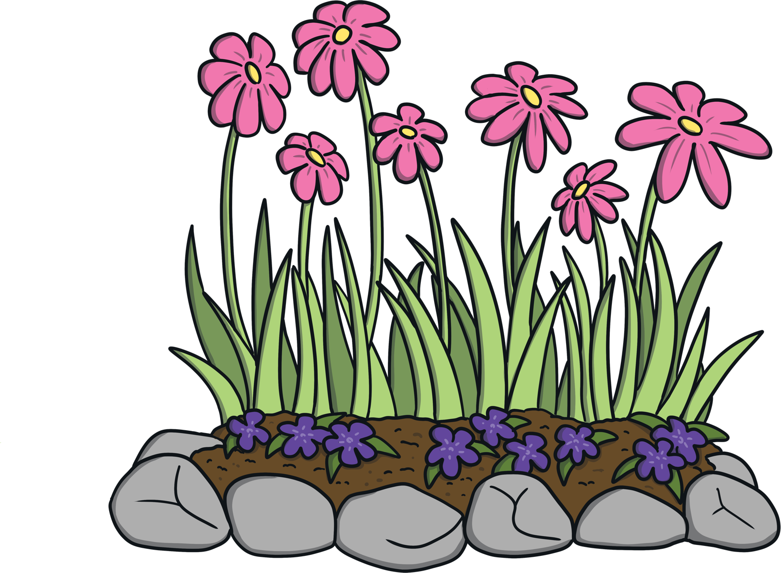
What Do
Bees Eat?
Bees like to feed on nectar and pollen. Nectar is a sweet, sugary liquid that bees drink from flowers.
Nectar tastes very sweet.
Pollen is often dusty and yellow - it gets stuck to my legs and body!

Slide 8
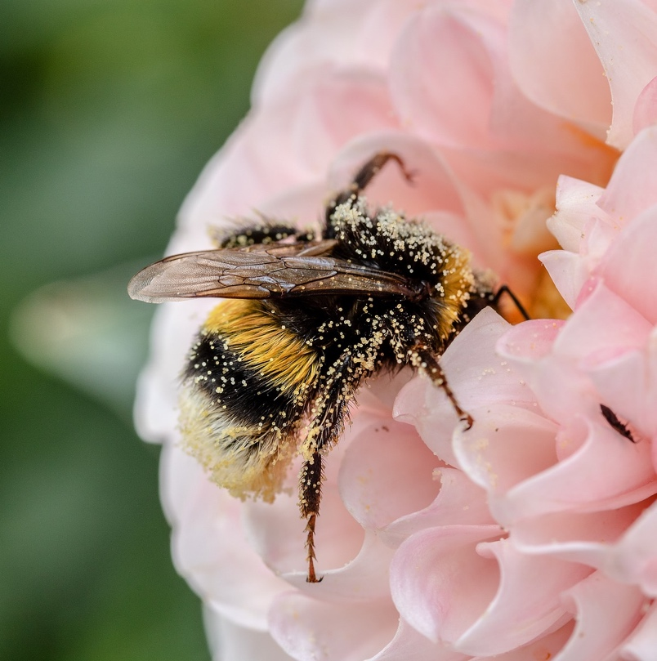
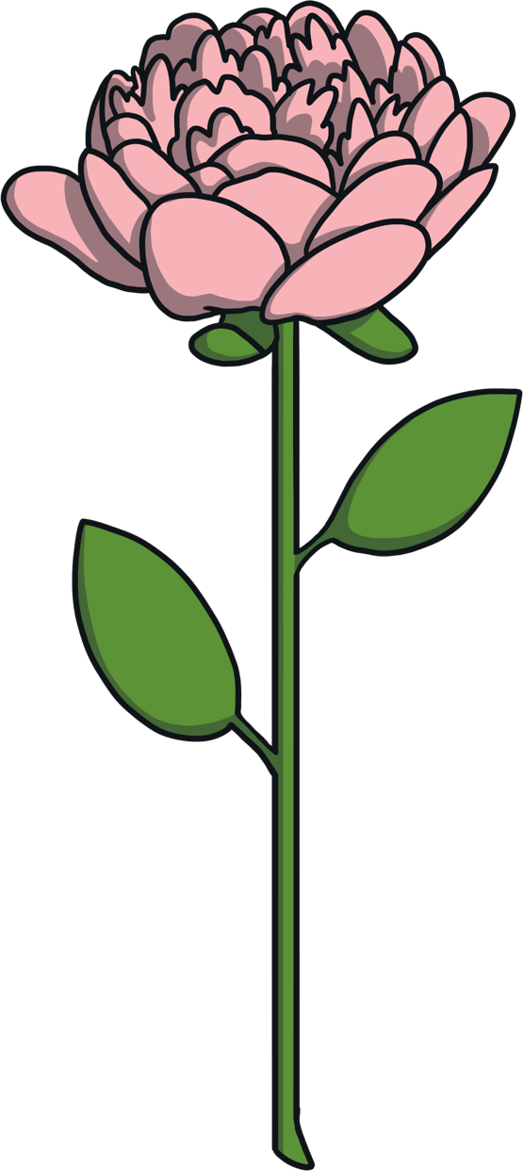


What Is Pollination?
The pollen that was stuck to their legs rubs off onto the next flower. This is called pollination. It helps plants to grow and produce food.
When bees have finished drinking all of the nectar on one flower, they fly to the next one.
Can you see the pollen that is stuck to this bee?

Slide 9
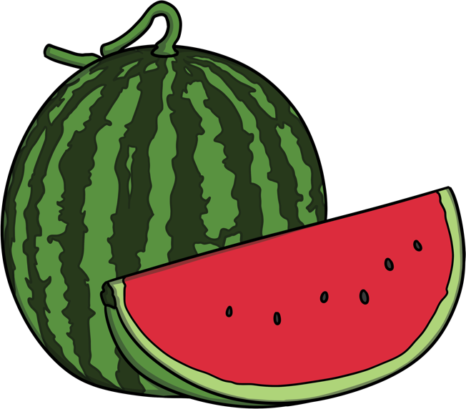
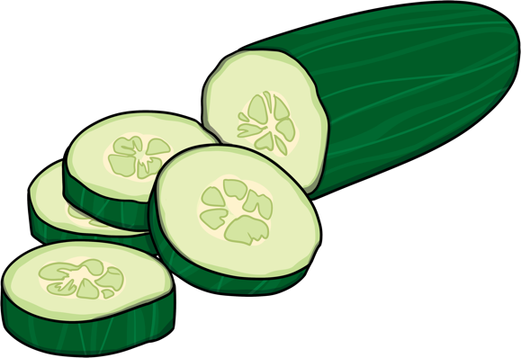
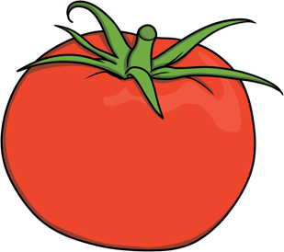
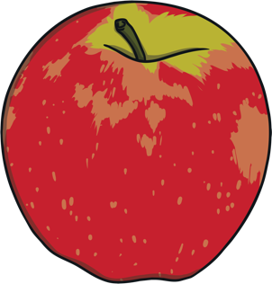
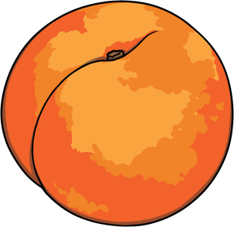
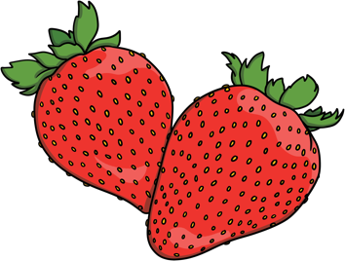
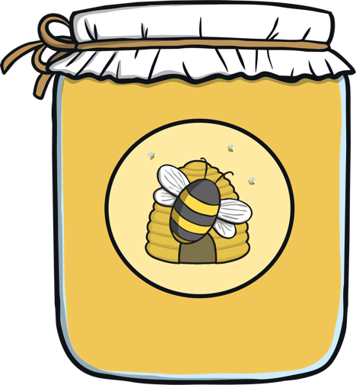
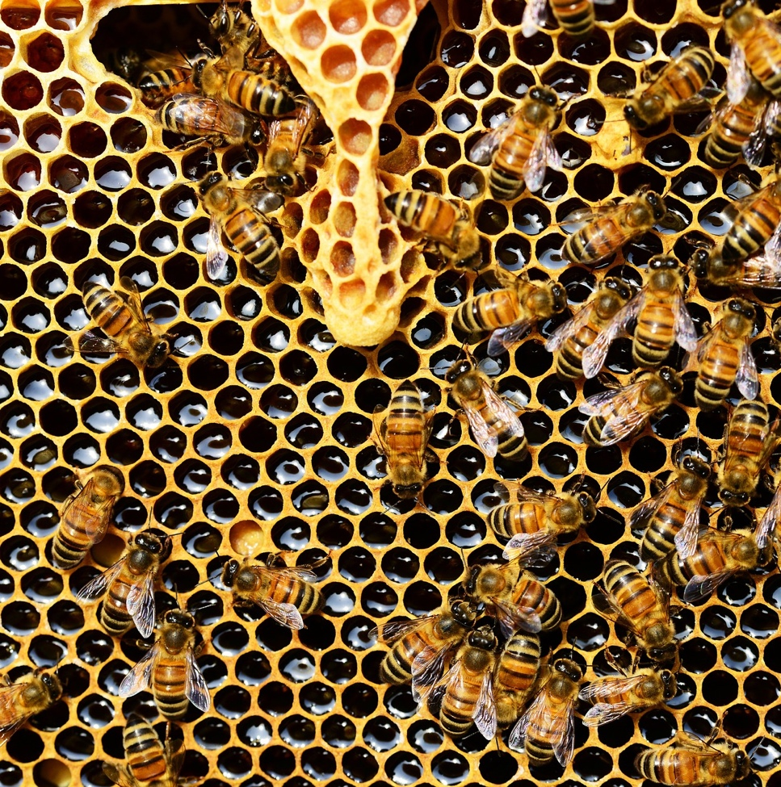
How Do Bees
Help Us?
By pollinating lots of different plants, bees help plants and fruits to grow.
Honey bees also produce lots of honey.
We make honey and store it as food for the winter, when there
are fewer flowers.

Slide 10
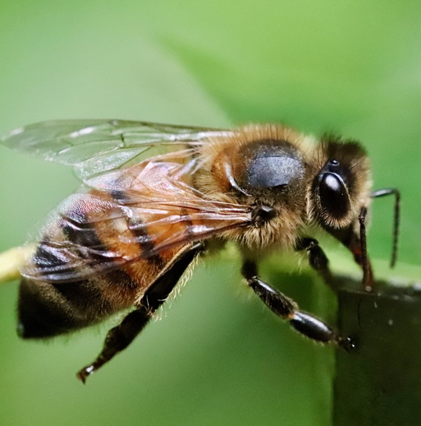
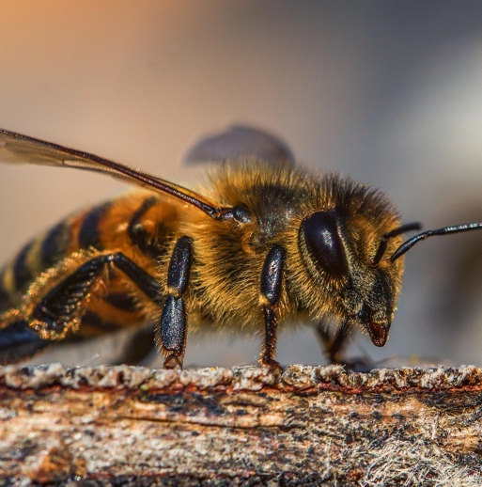

Facts About
Bees
Bees have four wings.
They have two wings on
each side of their body.
  Honey bees do a ‘waggle dance’ - although they are not actually dancing! It is a clever way for them to tell the other bees where to find food.
The noise a bee makes comes from
its wings. Its wings can move 200 times each second.

Slide 11

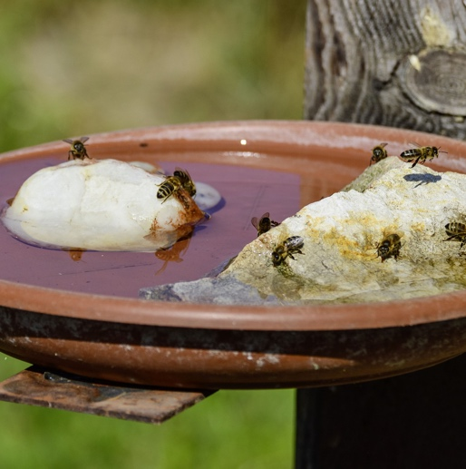
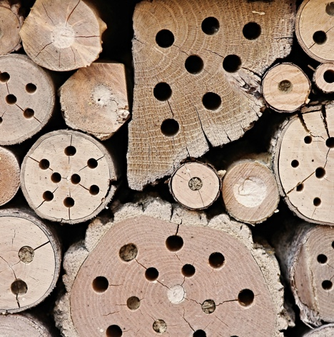
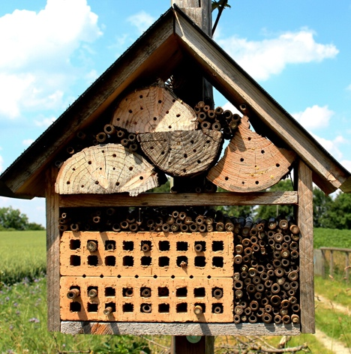
How Can We
Help Bees?
Plant bee-friendly flowers in your garden or other open spaces.
  Create a bee pond. Bees can’t swim and don’t like getting their wings wet but they do need water. Leave a shallow dish of water out for bees to drink from.
Build some bee hotels
or bee nests.

