Slide 1
Disclaimer/s
We hope you find the information on our website and resources useful.
Animations
This resource has been designed with animations to make it as fun and engaging as possible. To view the content in the correct formatting, please view the PowerPoint in ‘slide show mode’. This takes you from desktop to presentation mode. If you view the slides out of ‘slide show mode’, you may find that some of the text and images overlap each other and/or are difficult to read.
To enter slide show mode, go to the slide show menu tab and select either from beginning or from current slide.
We hope you find the information on our website and resources useful. This resource contains the sensitive and upsetting topic of racial discrimination. Sensitive and/or upsetting topics may emotionally impact your students due to past experiences. You should consider whether this content is appropriate and ensure adequate support is available for anyone affected.

Slide 3
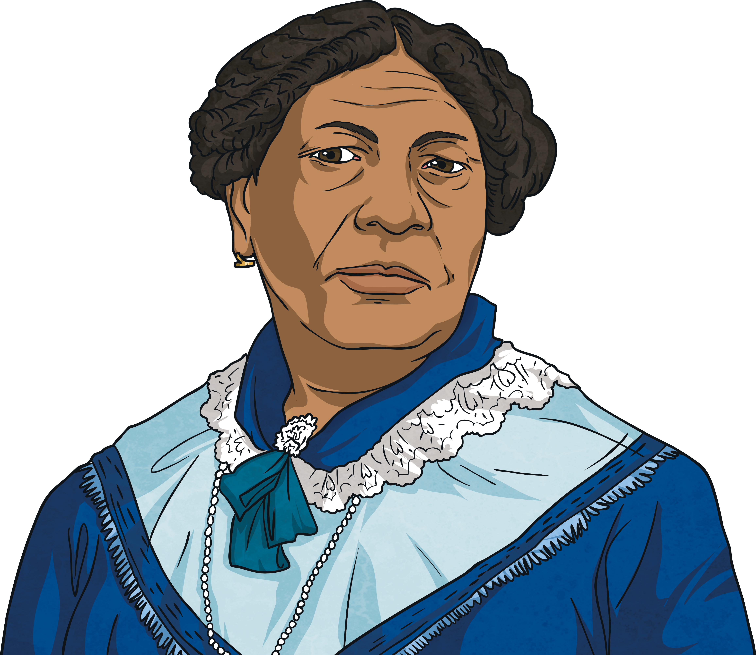
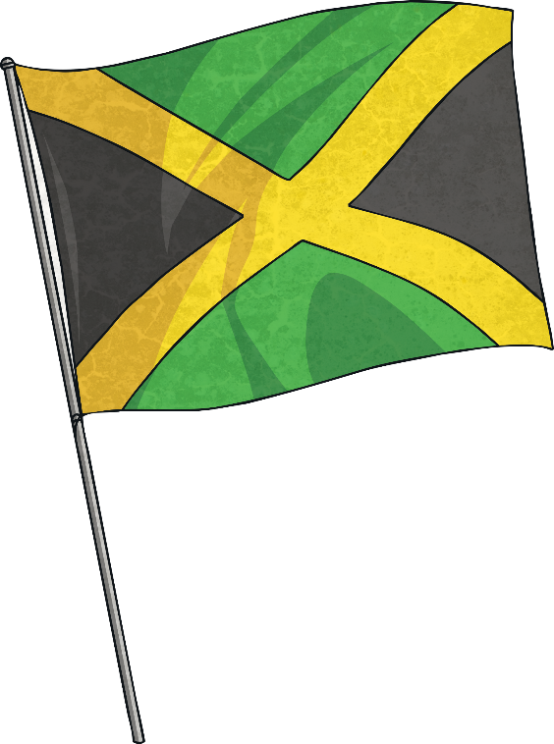
Who Was Mary Seacole?
Mary Seacole was a British-Jamaican woman who overcame racism to help others.
She is most famous for travelling to Crimea in 1855 to help care for soldiers wounded in the war. The soldiers even called her ‘Mother Seacole’.
racism: When people are not given respect, their rights, dignity or value because of their race. A race is a grouping of people who share some of the same physical features (such as skin colour and hair texture) and non-physical features (such as culture, history, religious beliefs and language).
X
glossary

Slide 4
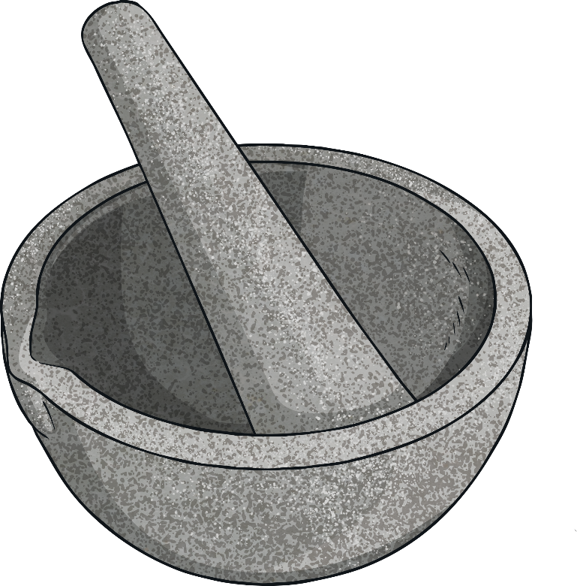
The Life of Mary Seacole
Mary Seacole (then known as Mary Grant) was born in Kingston, Jamaica in 1805.
Her father was a Scottish soldier and her mother was a Jamaican ‘doctress’. A doctress was a healer who used African and Caribbean herbal remedies.
Mary Seacole learnt about herbal remedies from her mother.

Slide 5
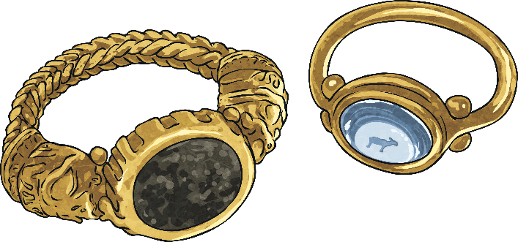
The Life of Mary Seacole
Mary was well educated and well travelled.
On November 10th 1836, Mary married Edwin Horatio Hamilton Seacole, godson of Lord Admiral Nelson, in Kingston. He sadly died eight years later.

Slide 6
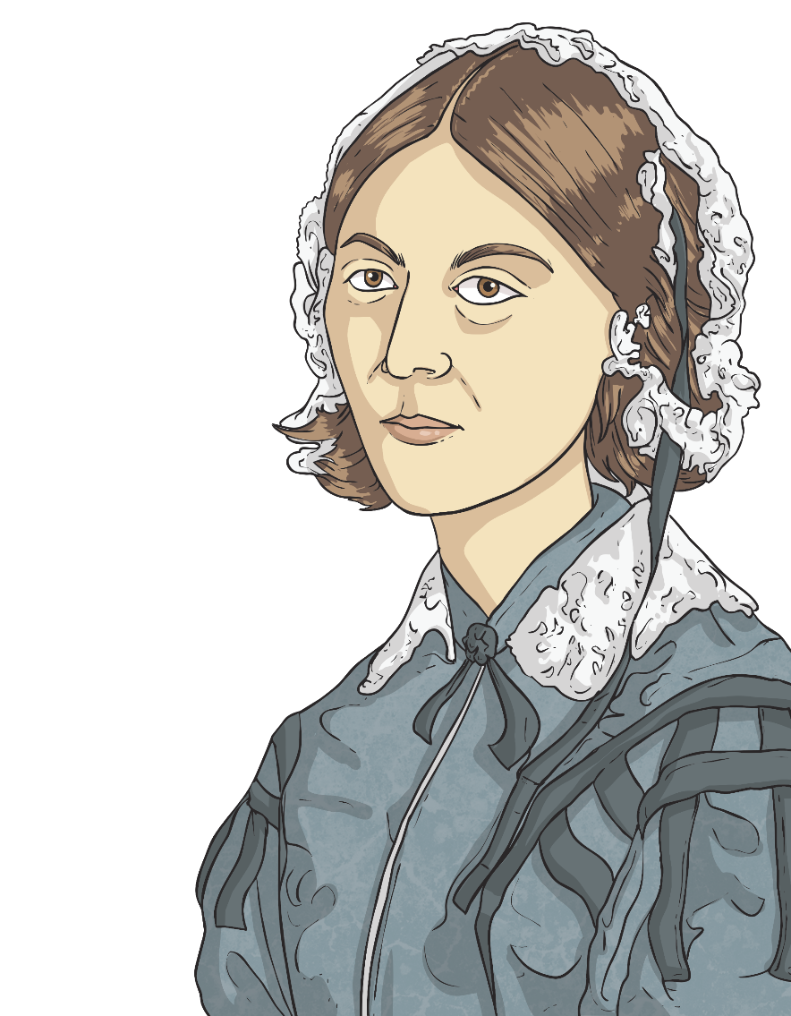
The Crimean War
She travelled to London to visit the War Office. She wanted to help with the work Florence Nightingale had started.
Although Seacole had very good references, her offer of help was turned down. This was very likely because of racism. Seacole was a Mixed Heritage woman and was treated unfairly because of her race at different times during her life. Racism is now against the law but it wasn’t when Mary Seacole was alive. Unfortunately, racism is still something that affects the lives of people today.
racism: When people are not given respect, their rights, dignity or value because of their race. A race is a grouping of people who share some of the same physical features (such as skin colour and hair texture) and non-physical features (such as culture, history, religious beliefs and language).
X
glossary

Slide 7
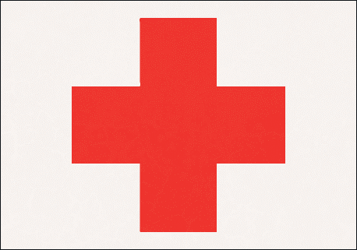
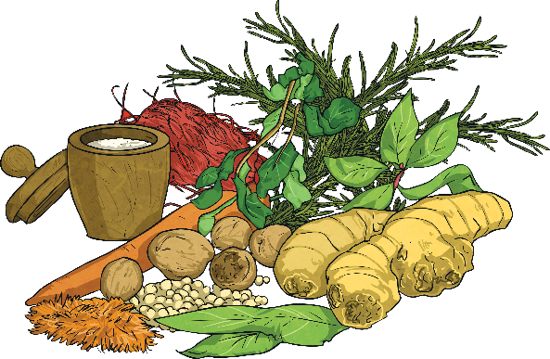
The Crimean War
Seacole decided she would pay for herself to get to Crimea.
She set up a boarding house and restaurant there called the ‘British Hotel’.
This provided her with some income.
Seacole cared for and treated the injured soldiers with her herbal remedies.
She even travelled to the location of the fighting and treated soldiers there.

Slide 8
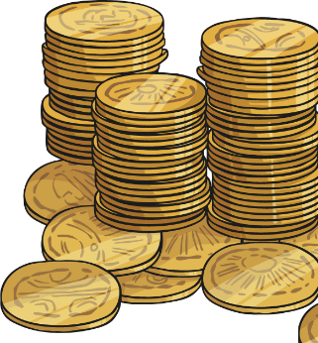
After the War
After the war, Seacole returned to Britain. She had no home and was in bad health.
The British people heard of Seacole’s good work. They wanted to help her so they held a fundraiser to raise money.
In 1857, a book was published about her life. 'The Wonderful Adventures of Mrs Seacole in Many Lands' was an autobiography. It was one of the first to be written by a Black woman in Britain.

Slide 9
After the War
Mary Seacole died on 14th May 1881, at the age of 76, in her home in London.
After her death, Seacole and her work were sadly forgotten. However, about 100 years later, a group of Jamaican nurses wanted to know more about her and started to make her famous again.
In 2016, a statue built in her honour was unveiled at St Thomas' Hospital in London.

Slide 10
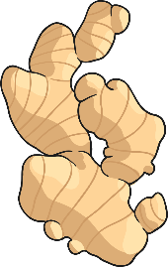
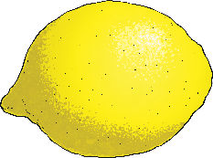
Herbal Remedies
Mary Seacole mixed plants together to make herbal medicine to help the wounded soldiers, as other medicines were not easily available.
These are some of the ingredients she used in her medicines:
lemongrass, boiled to help a fever;
aloe vera, mixed to help heal cuts and wounds;
ginger, ground to help diarrhoea;
lemons, mixed to help coughs;
okra, chopped to heal boils.
She would grind ingredients with a pestle and mortar, mix them in a mixing bowl or place them in a pan over a fire.
In some countries, remedies like this are still used today.

