Slide 1
Bubbles
A Literacy Shed Film by Gabby Zapota
https://www.literacyshed.com/bubbles.html

Slide 2
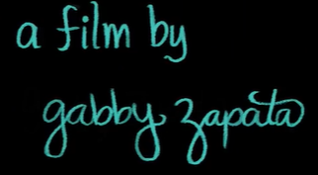
Bubbles by Gabby Zapata

Slide 3
Tuesday 7th May 2024 LO: To orally create sentences using the ‘and to join clauses.
Twinkl-What’s that sound?
https://www.youtube.com/watch?v=oIeLlHug28A

Slide 4
Tuesday 7th May 2024 LO: To orally create sentences using the ‘and to join clauses.
Twinkl-What’s that sound?
Ask questions:
Have you ever been to a beach?
What can they remember about it?
What was there?
What things could you find on a beach?

Slide 5
(Listen to Twinkl’s What’s that sound beach ppt)
Sound track of the beach…
What is you beach like?
Does it have yellow sand?

Slide 6
(Listen to Twinkl’s What’s that sound beach ppt)
Sound track of the beach…
What is you beach like?
What can you smell?

Slide 7
(Listen to Twinkl’s What’s that sound beach ppt)
Sound track of the beach…
What is you beach like?
What can you hear?

Slide 8
What can you see? Hear? Smell? Taste? Touch?

Slide 9
All- Join their stick note sentence with their partners sticky note sentence, using ‘and’ as their conjunction.
Y2 Extension using…
because, but, or, yet, and, so conjunctions too.
Describe their nouns and record their sentences.
Ensure that they orally say their sentences using the conjunction ‘and’ before writing them down in their books.

Slide 10
Wednesday 8th May 2024 LO: To create a setting description
Play vocabulary Ping Pong- word association game.
Teacher calls out a word and the children whilst facing each other try to list as many words (one at a time) as possible linked to this topic of the beach.
Look at the images on Resource 1b.
Beach, weather, sea, boats, rock pools.

Slide 11
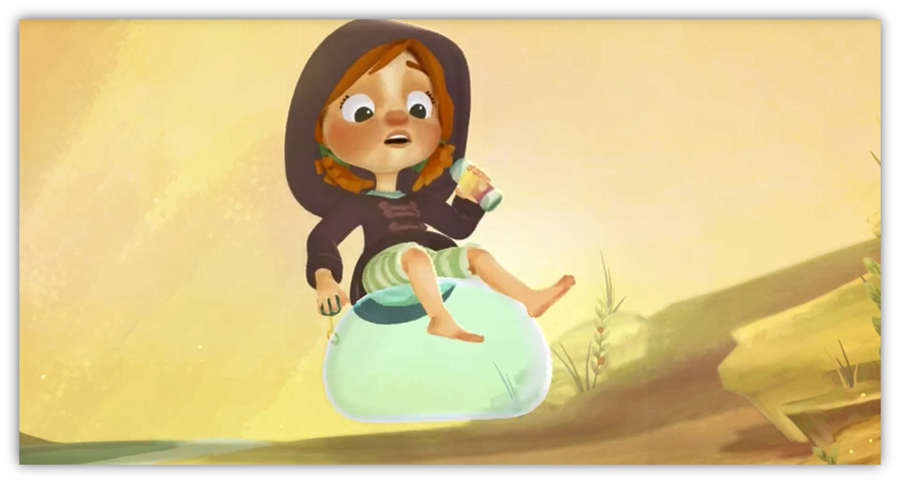
Share images of the beach 1b
Discuss their image and create a sentence based on their check list
Key Questions 1a
Show Gabby in the Bubbles film (first 15 seconds).
What could she, hear, see, smell?
3rd person.

Slide 12
Activity:
All: Children are to compose and record at least sentences about the beach setting. Encourage the use of adjectives.
Extension: Encourage the children to add an adjective to every noun using their senses.

Slide 13
Thursday 9th May 2024 LO:To discuss the significance of the title and the events. To participate in discussion about what they see, taking turns and listening to what others have to say.

Slide 14
Bubbles
A Literacy Shed Film by Gabby Zapota
https://www.literacyshed.com/bubbles.html

Slide 15
Recall the sequence of events in the film ‘Bubbles’ by Gabriela Zapata
Play the film again
Using resource 3a to guide your discussion and 3b activity sheet,
Record their answers from each section…
14 seconds How is she feeling?
1min 5 seconds What can you see? Descibe it? What is it doing? Where is it? Can you put this imformation into one sentence?
1 minute 17 seconds
What can she see? Colour? Etc. Record sentences.
1 minute 21 seconds How is she feeling now?
Discuss what they have liked and disliked about this film.
Write this in their bubble 1c

Slide 16
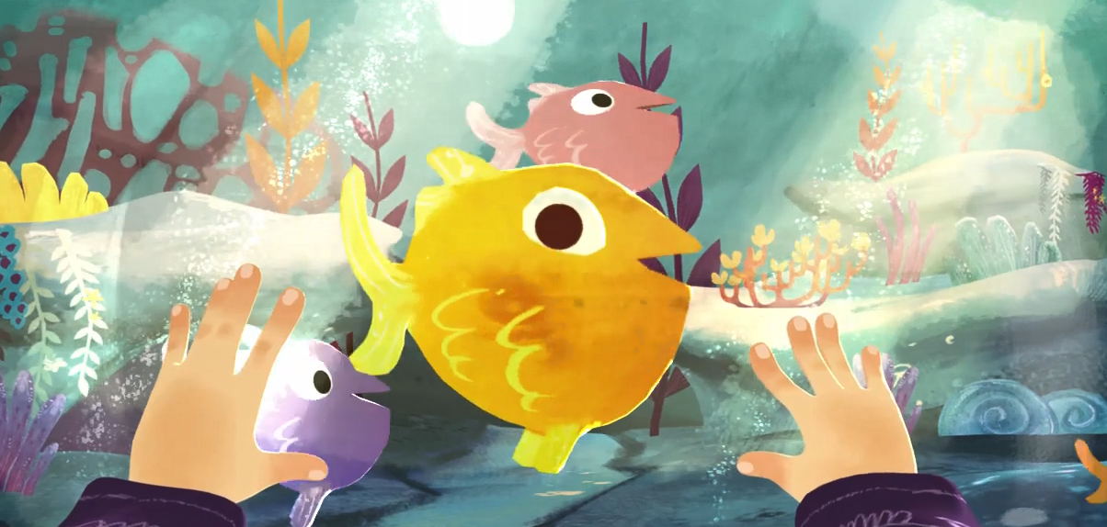
Bubble Adventure…
?

Slide 17
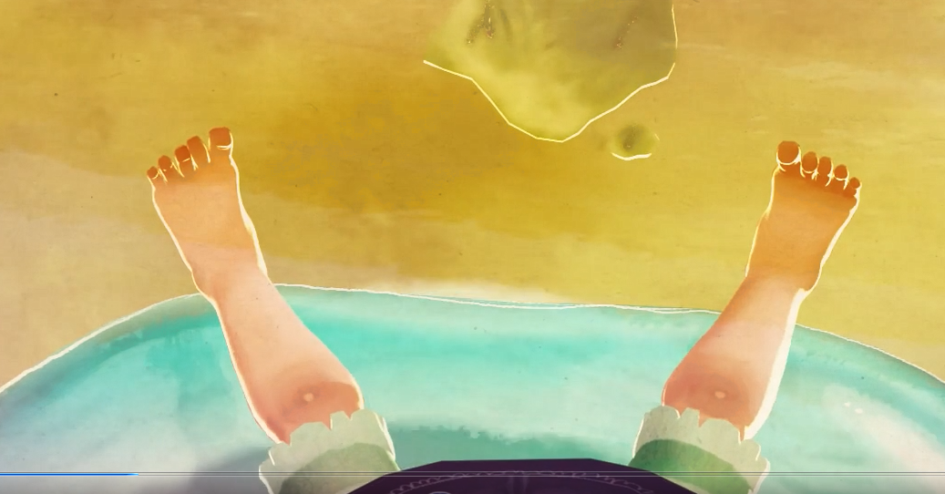
Floating up into the sky above! Look way down below…

Slide 18
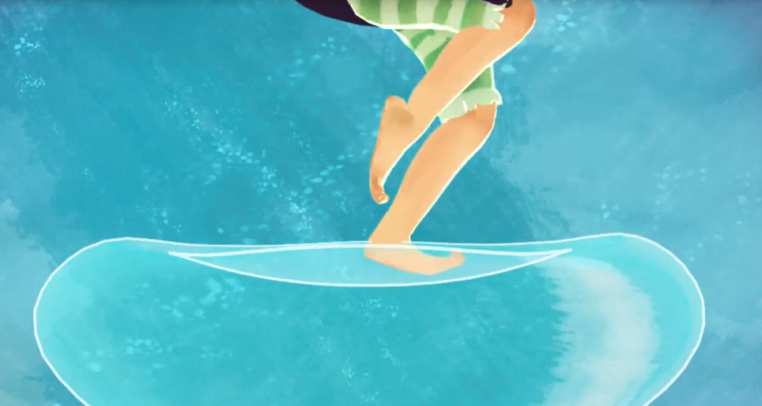
Bounce! Bounce! Bounce!
First bullet point here
Second bullet point here
Third bullet point here
Class | Group 1 | Group 2
Class 1 | 82 | 95
Class 2 | 76 | 88
Class 3 | 84 | 90

Slide 19
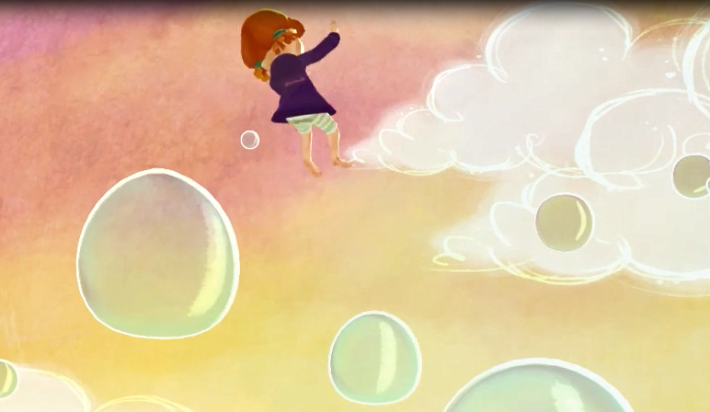
Jumping, floating and spinning through the air!

Slide 20
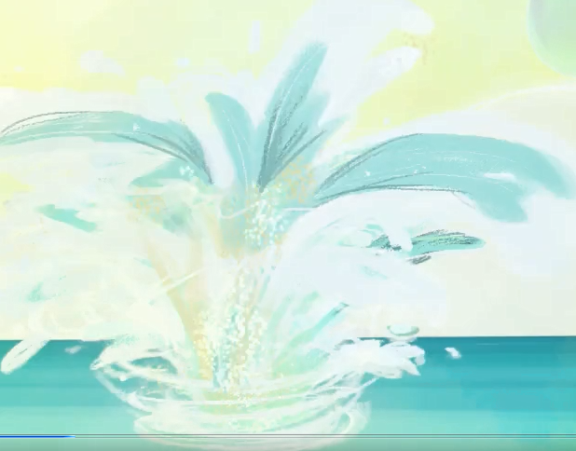
Descending down, down, down and SPLASH!

Slide 21
Friday 10th May 2024 LO: To create a short section of descriptive narrative

Slide 22
Using resources 3c.
The boy is on a green skateboard. The little child is rowing a boat on the lake.
Write some sentences about the classroom?
Looking at the image of Gabby in space…
(1 minute 16seconds)

Slide 23
Use resource 4b examples
Discuss what they can see.
Describe the colours using simple adjectives.
E.g.
‘shiny moon’ ‘twinkly stars’
Write the sentence on the board. Link them using conjunctions.

Slide 24
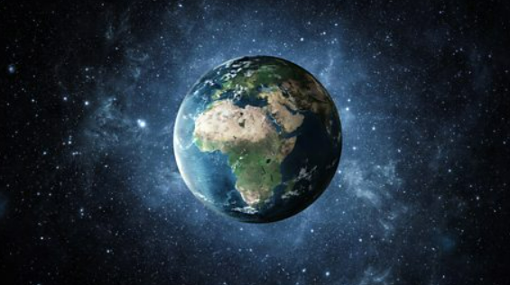
Write about Space using adventurous vocabulary and adjectives.
Extension-Describe their own detail, rather than purely using the film.

Slide 25
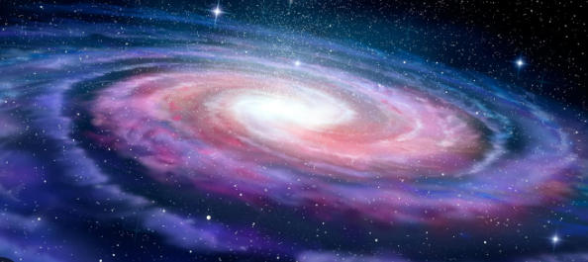
Write about Space using adventurous vocabulary and adjectives.

Slide 26
Wish upon a star…

Slide 27
Year 1 Writing Targets- Reports
Write sentences in order to create short narratives and non-fiction texts.
Use some features of different text types (although these may not be consistent).
Re-read their writing to check that it makes sense and make suggested changes.
Use adjectives to describe.
Use simple sentence structures.
Use the joining word (conjunction) ‘and’ to link ideas and sentences.
Capital letters for names, places, the days of the week and the personal pronoun ‘I’.
Beginning to use finger spaces.
Beginning to use full stops to end sentences.
Beginning to use question marks.
Beginning to use exclamation marks.
Spell most words containing previously taught phonemes and GPCs accurately.
Spell most Y1 common exception words and days of the week accurately.
Use -s and -es to form regular plurals correctly.
Use the prefix ‘un’.
Add the suffixes –ing, -ed, -er and –est to root words (with no change to the root word).
Write lower case and capital letters in the correct direction, starting and finishing in the right place.
Write lower case and capital letters in the correct direction, starting and finishing in the right place with a good level of consistency.

Slide 28
Year 2 Writing Targets- Reports
Write simple, coherent narratives about personal experiences and those of others (real or fictional).
Write about real events, recording these simply and clearly.
Demarcate most sentences in their writing with capital letters and full stops.
Use question marks correctly when required.
Use present tense mostly correctly and consistently.
Use past tense mostly correctly and consistently.
Use co-ordination (eg or / and / but) to join clauses.
Use some subordination (eg when / if / that / because) to join clauses.
Segment spoken words into phonemes and represent these by graphemes, spelling many of these
words correctly and making phonically-plausible attempts at others.
Spell many common exception words.
Form capital letters and digits of the correct size, orientation and relationship to one another and to lower-case letters.
Use spacing between words that reflects the size of the letters

